Slide 1
Mar.6, 2019
You need:
Clean paper (2) / Pencil
Protist Grid/chart (done in class Mon.)
Warm Up:
Mental Math – be ready.
I CAN: identify the parts of the microscope.

Slide 2
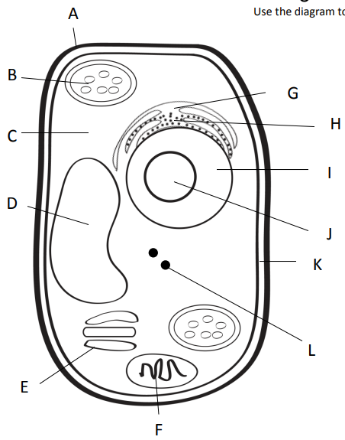
Outer most part of plant cell.
Makes food from sunlight
Road (smooth)
Road (rough)
Gel surrounding all
Controls cell
Storage
Copies ribosomes
Inner part of outer covering of plant cell.
Protein factory
Packaging plant
Power factory

Slide 3
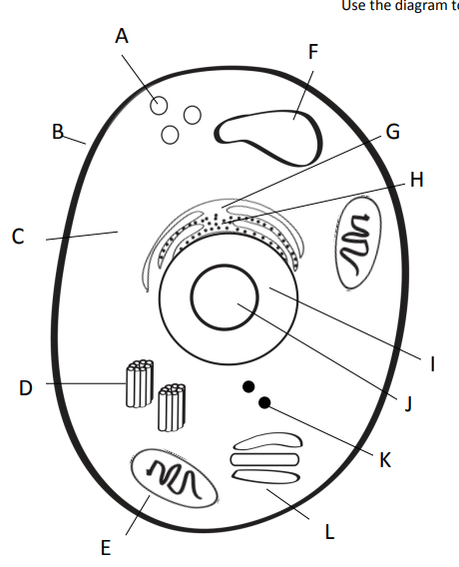
Clean up (pac-man)
Storage
Outer covering of an animal cell.
Road (smooth)
Road (rough)
Gel surrounding all
Controls cell
Copies ribosomes
Centrioles = help in cell division (reproduction)
Protein factory
Power factory
Packaging plant

Slide 4
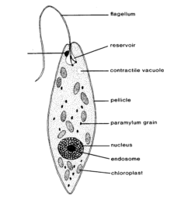
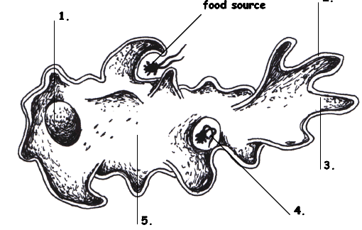
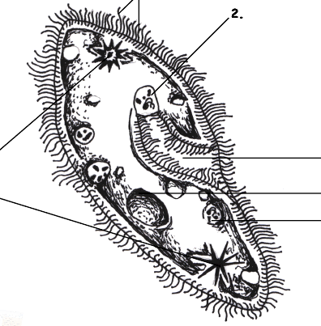
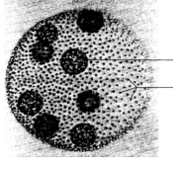
Protists…
Euglena, Amoeba,
Paramecium, and Volvox
Amoeba Sisters video

Slide 5
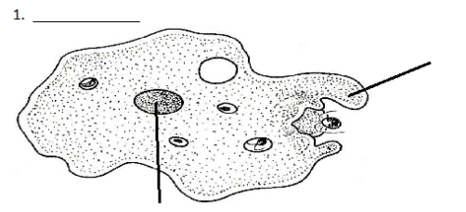
Amoeba
Amoeba
Pseudopod (fake foot)
Nucleus

Slide 6
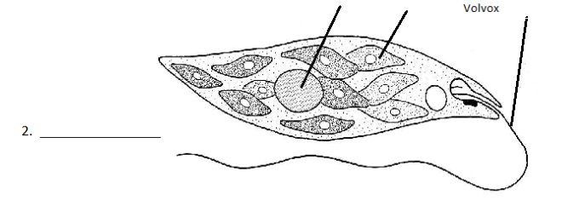
Euglena
Nucleus
Chloroplast
Flagella
Euglena

Slide 7
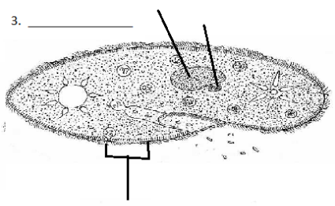
Paramecium
Macro (big) and micro (little) nucleus
Paramecium
Cilia

Slide 8
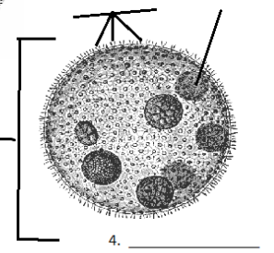
Volvox
Daughter colony
Adult Colony
Volvox

Slide 9
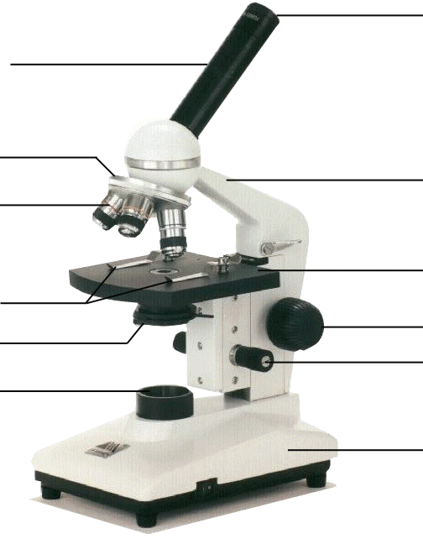
Compound Microscope
1. Eye Piece – lens closest to the eye.
2. Body Tube – gives distance between eyepiece and objective.
3. Nose Piece – holds the objectives.
4. Arm – holds the tube and lenses.
5. Objectives –
lens closest to the slide.
6. Stage – platform for the slides.
7. Stage clips –
Holds the slide in place.
8. Course Adjustment knob –
Moves stage up/down (to focus).
9. Diaphragm –
Controls the amount of light.
11. Light –
Shines light through the slide, lens, tube.
10. Fine Adjustment knob –
Moves stage up/down slightly
12. Base –
Holds up the entire microscope.

Slide 10
Today’s checklist
Although listed on the daily website post, I thought I’d list here, too.
Quizziz.com protist quiz – code 809652.
BrainPop – microscope video and quiz.
BrainPop – virtual microscope lab.
Virtual Microscope Lab (UD) – Be sure to record observations about the “e” and the onion cells.
Intro to Microscope Lab: protist, letter “e”, pre-made slide…RECORD OBSERVATIONS, ANSWER QUESTIONS!!

