Slide 1
Mar.5, 2019
You need:
Clean paper (2) / Pencil
Protist Grid/chart (done in class Mon.)
Warm Up:
Mental Math – be ready.
I CAN: identify the parts of the microscope.

Slide 3
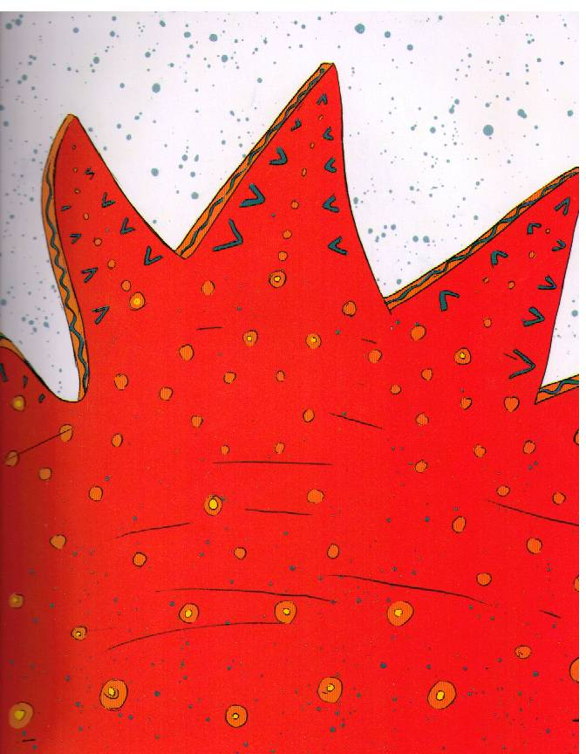

Slide 4
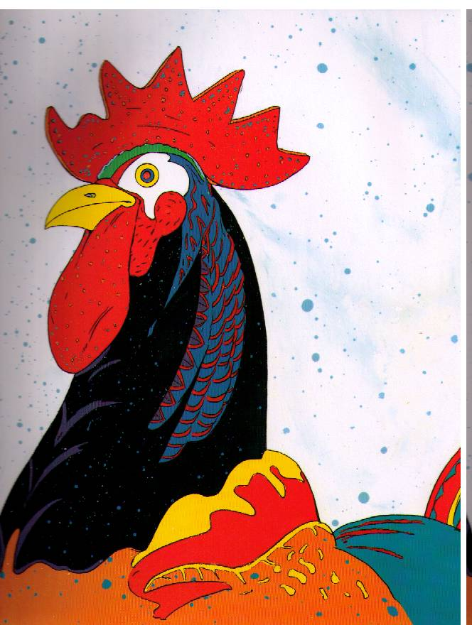

Slide 5
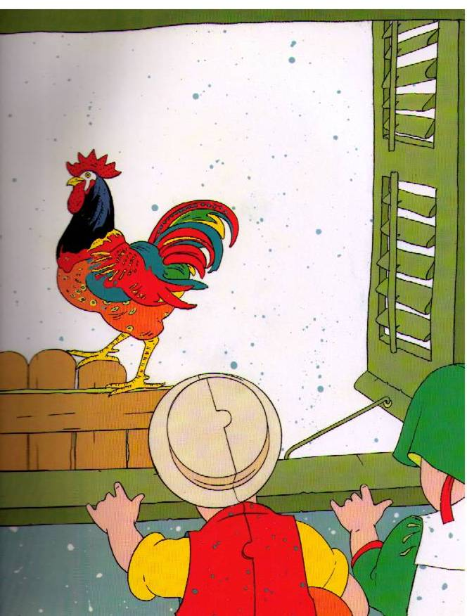

Slide 6
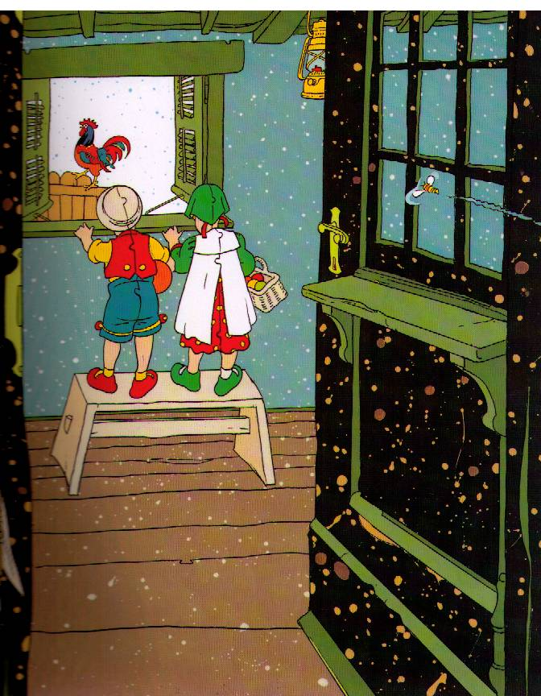

Slide 7
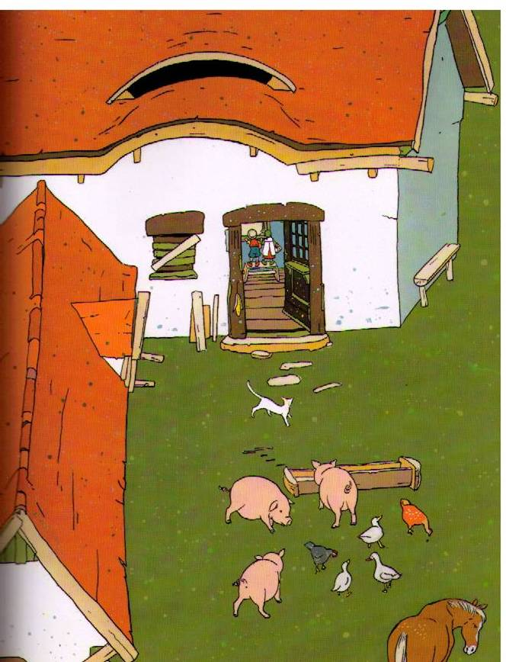

Slide 8
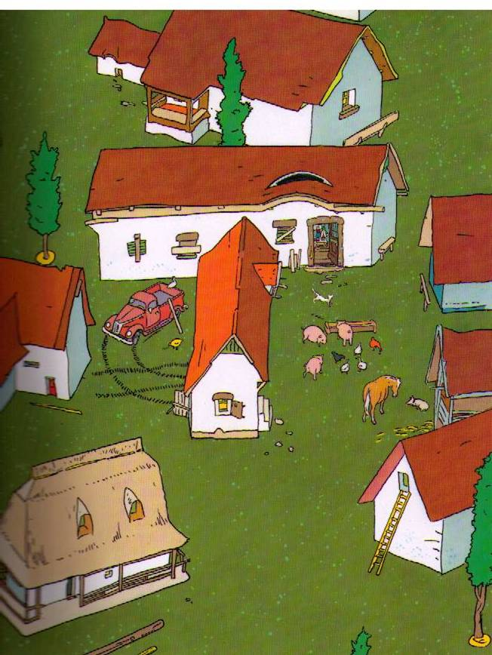

Slide 9
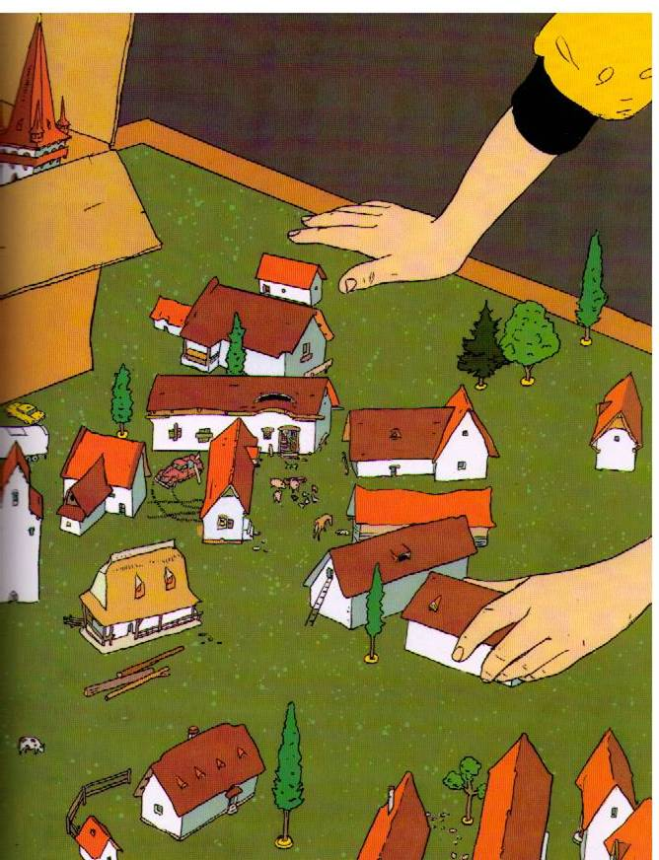

Slide 10
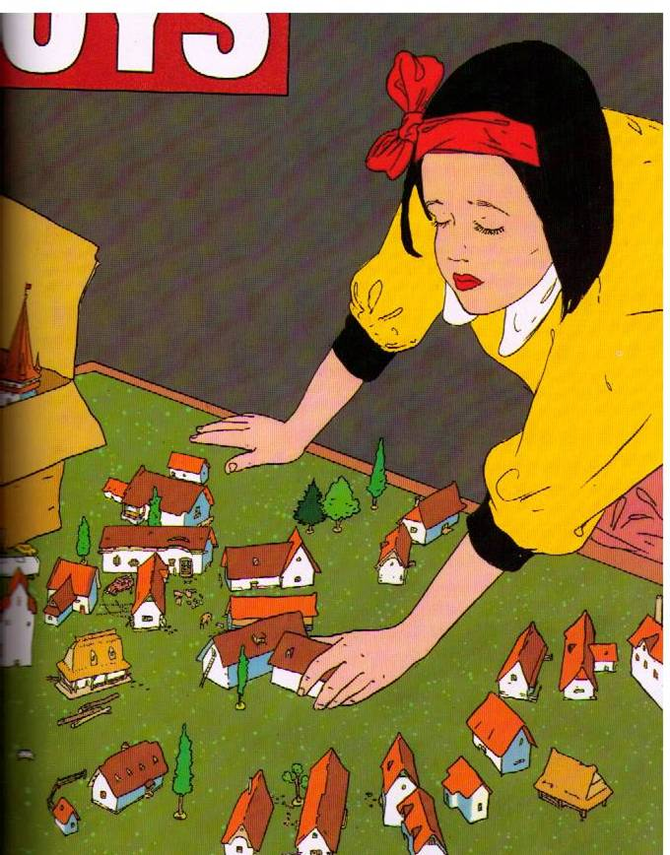

Slide 11
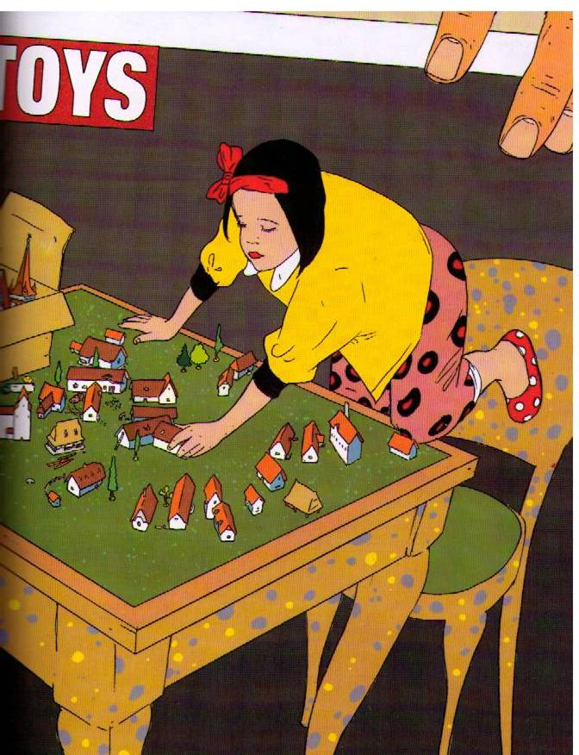

Slide 13
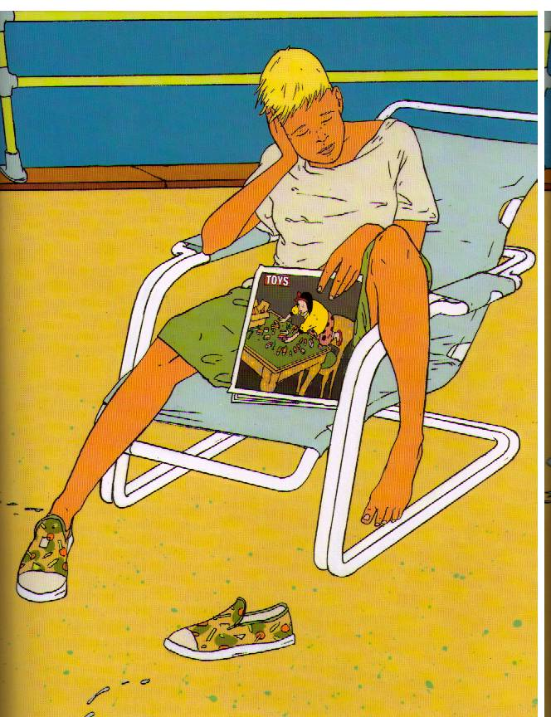

Slide 14
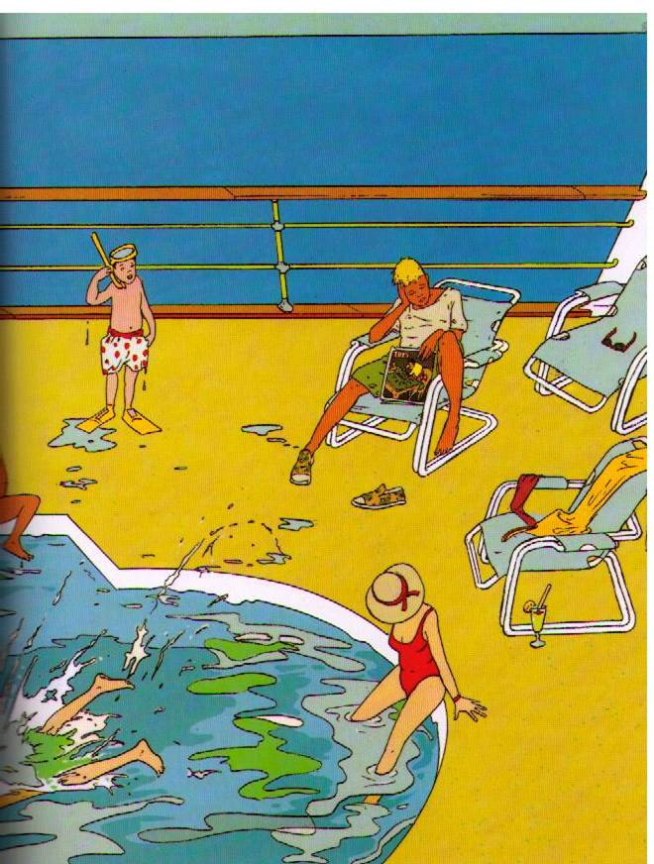

Slide 15
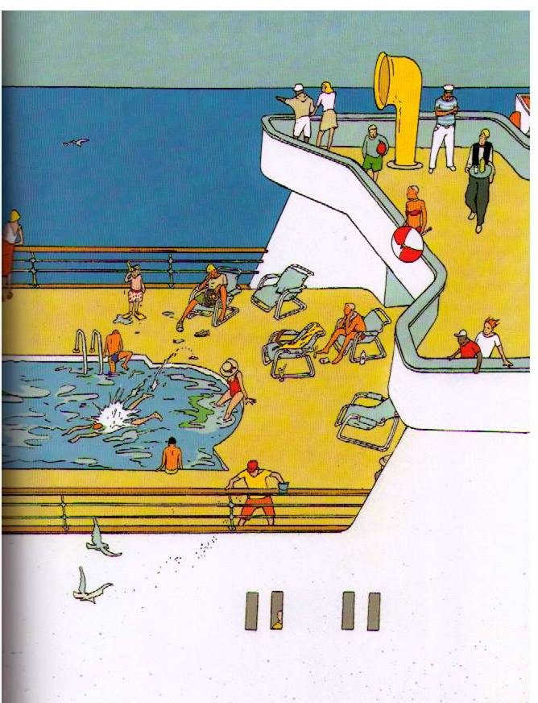

Slide 16
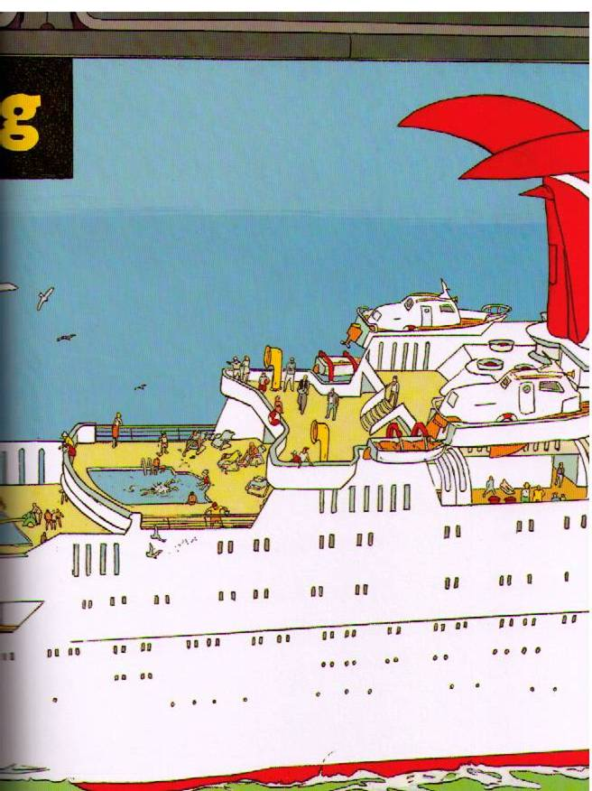

Slide 17
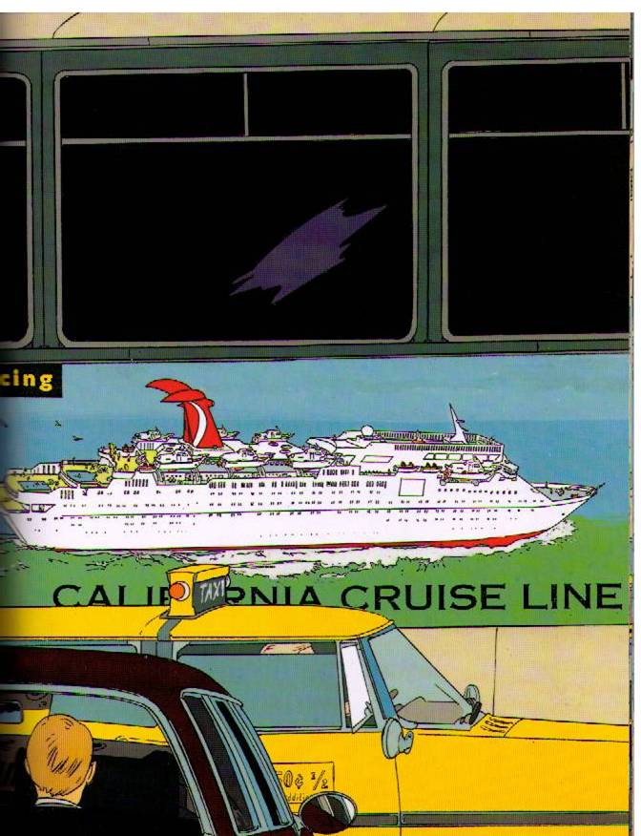

Slide 18
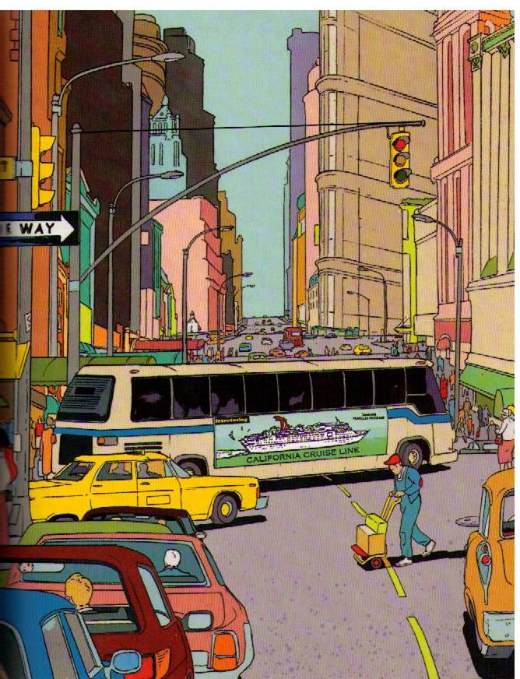

Slide 19
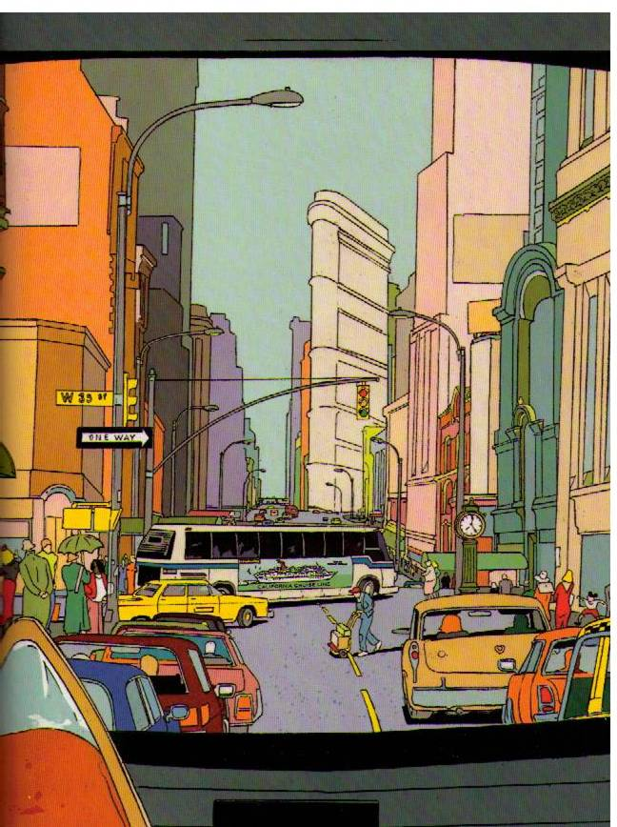

Slide 21
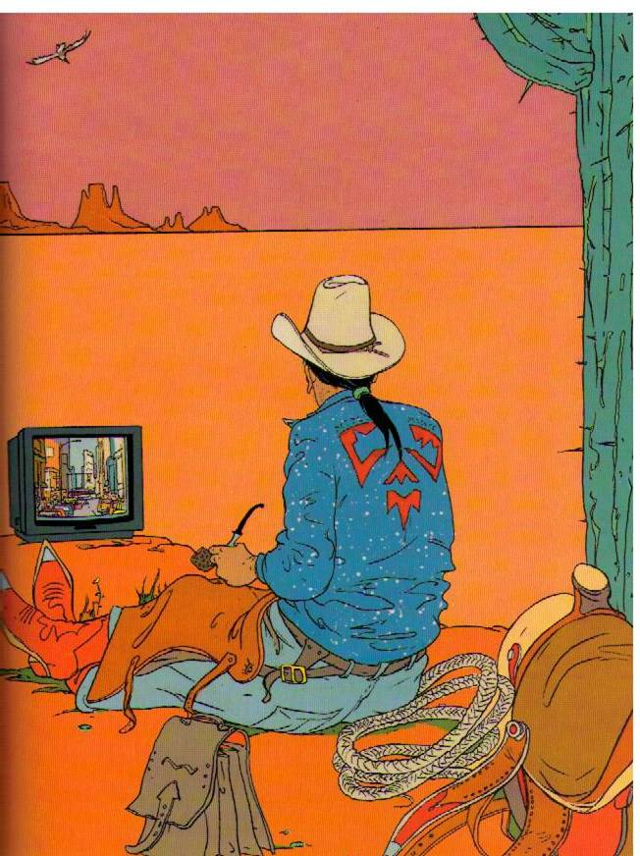

Slide 22
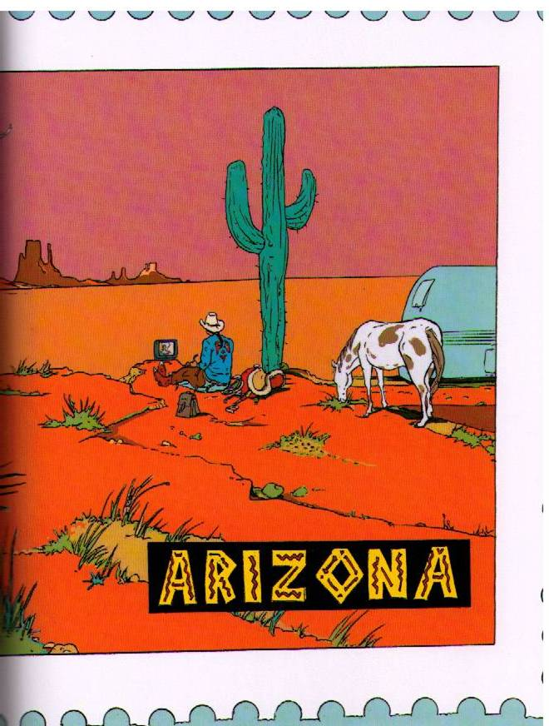

Slide 24
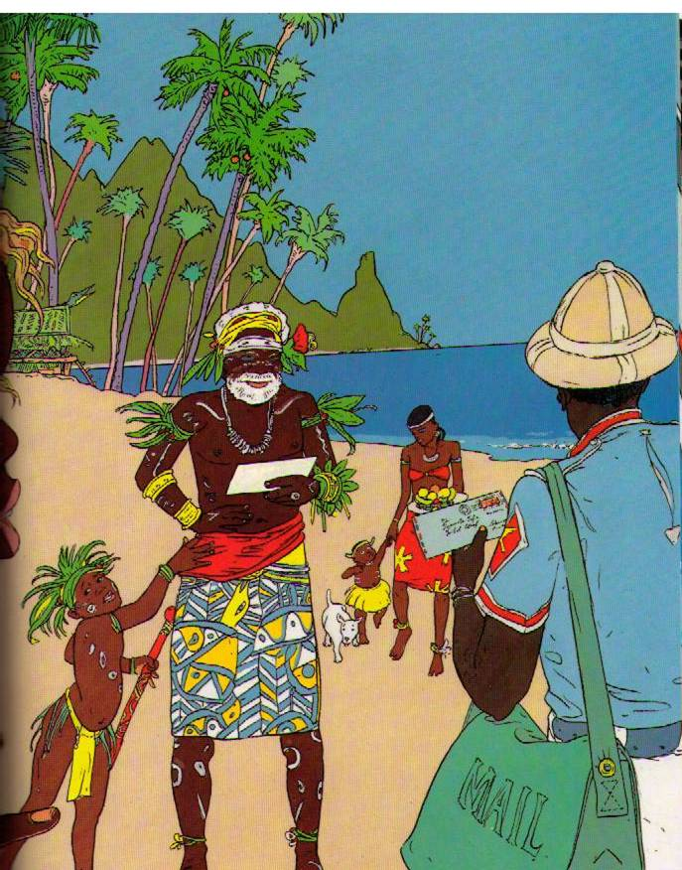

Slide 25
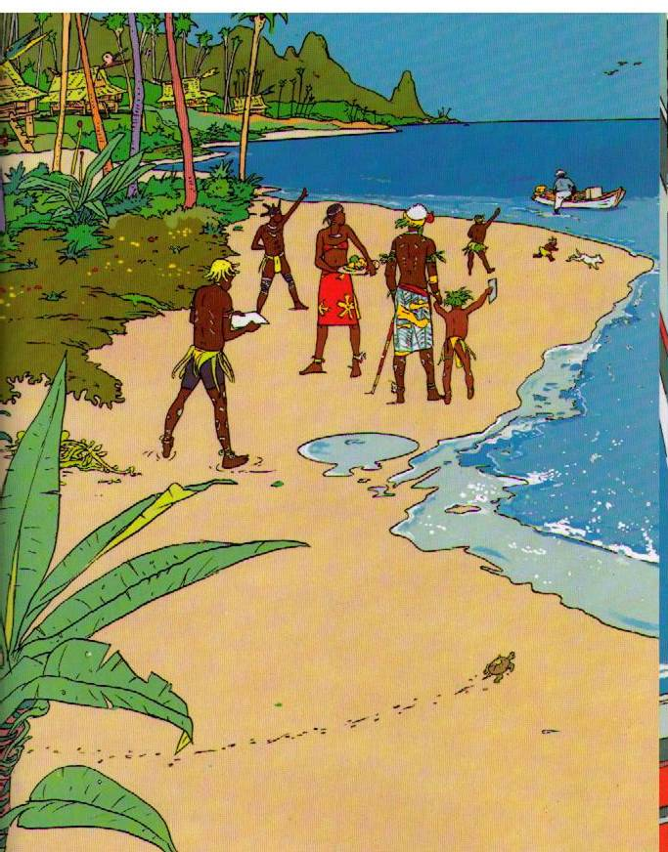

Slide 26
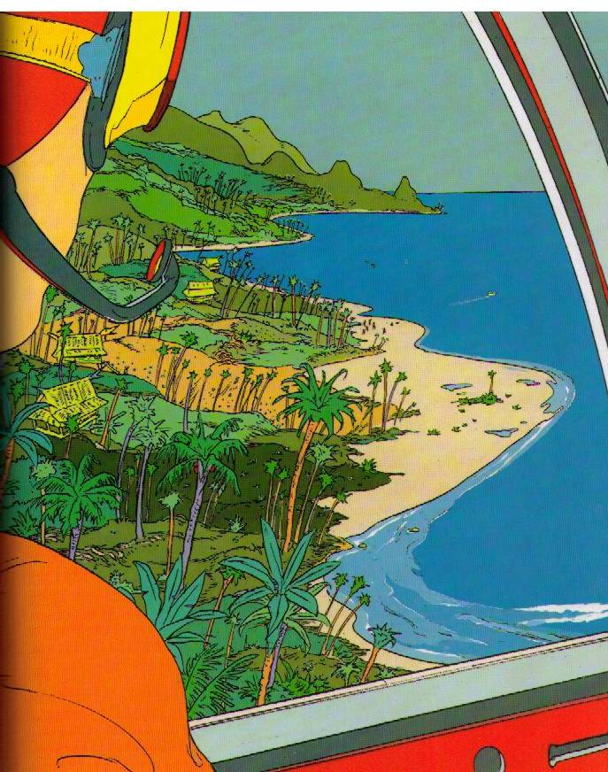

Slide 28
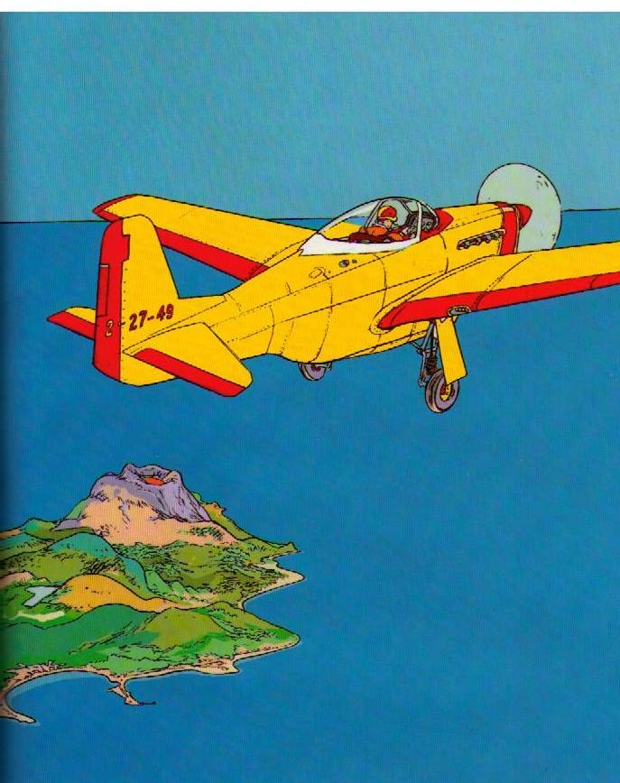

Slide 29
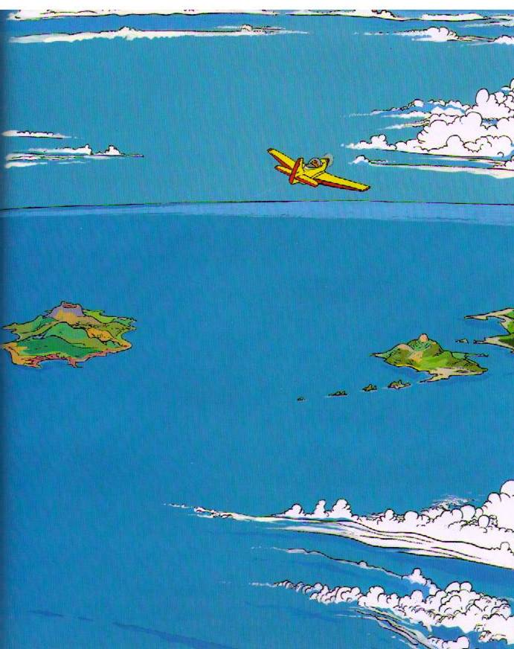

Slide 30
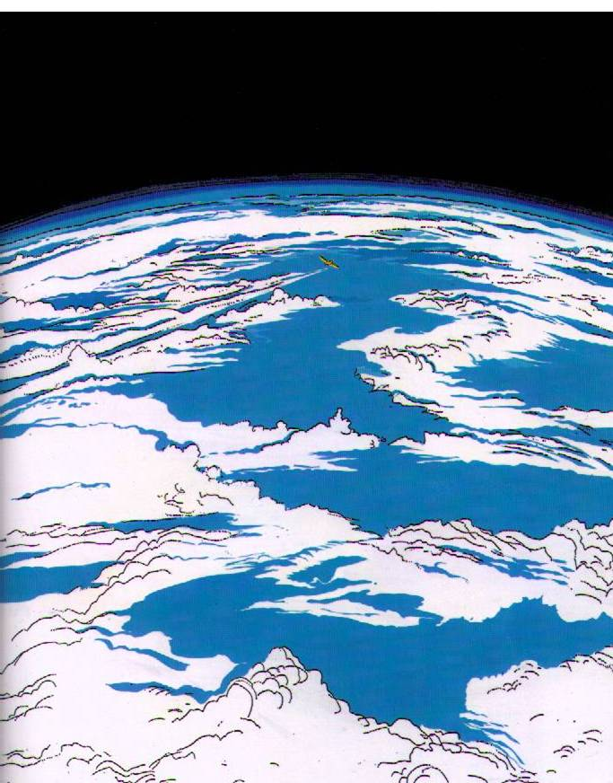

Slide 31
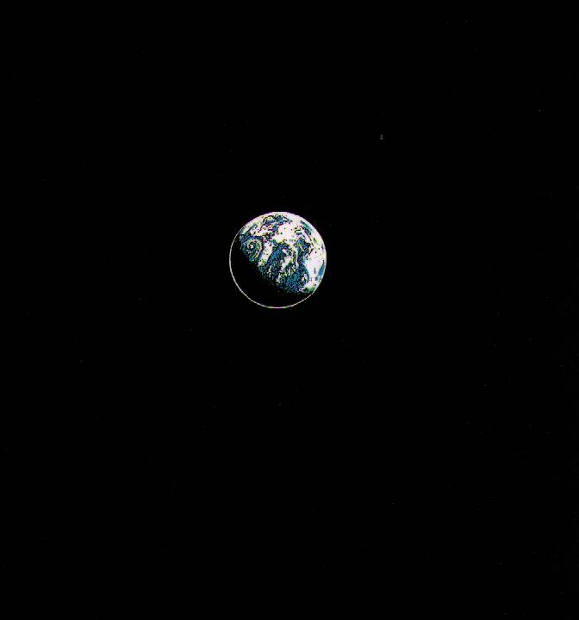

Slide 33
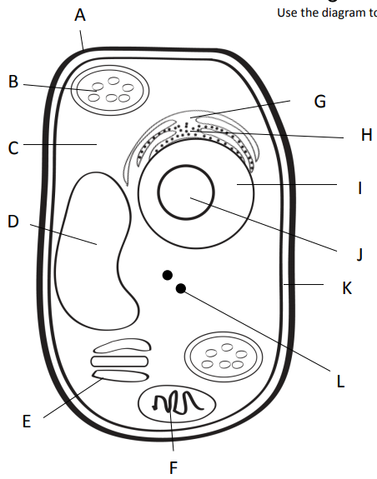
For Cane Cash
Outer most part of plant cell.
Makes food from sunlight
Road (smooth)
Road (rough)
Gel surrounding all
Controls cell
Storage
Copies ribosomes
Inner part of outer covering of plant cell.
Protein factory
Packaging plant
Power factory

Slide 34
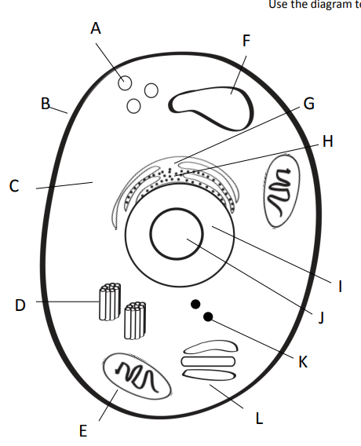
For Cane Cash
Clean up (pac-man)
Storage
Outer covering of an animal cell.
Road (smooth)
Road (rough)
Gel surrounding all
Controls cell
Copies ribosomes
Centrioles = help in cell division (reproduction)
Protein factory
Power factory
Packaging plant

Slide 35
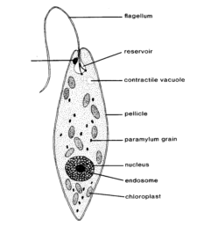
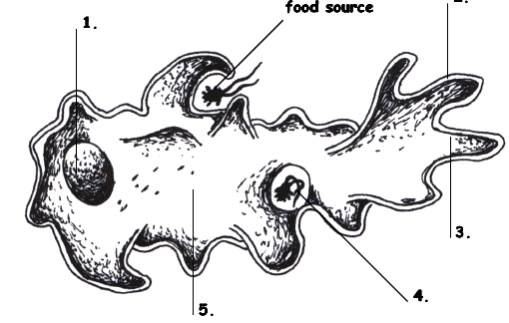
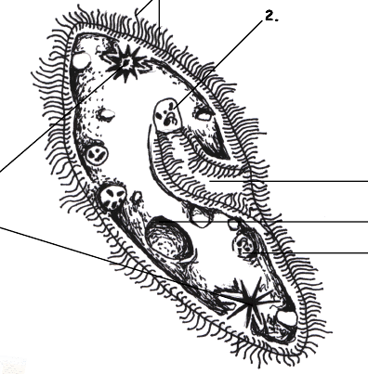
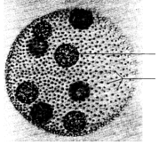
Protists…
Euglena, Amoeba,
Paramecium, and Volvox
Amoeba Sisters video

Slide 36
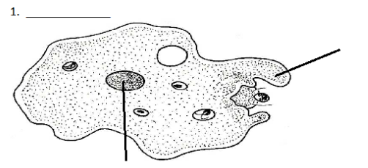
Amoeba
Amoeba
Pseudopod (fake foot)
Nucleus

Slide 37
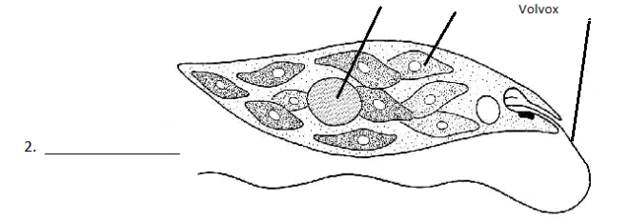
Euglena
Nucleus
Chloroplast
Flagella
Euglena

Slide 38
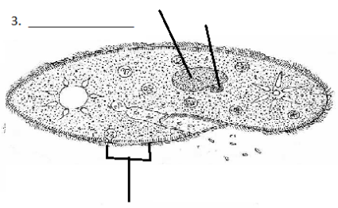
Paramecium
Macro (big) and micro (little) nucleus
Paramecium
Cilia

Slide 39
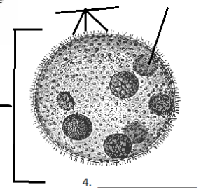
Volvox
Daughter colony
Adult Colony
Volvox

Slide 40
Species | Locomotion | Description (and sketch) | Autotroph or heterotroph | Reproduction
Amoeba
Paramecium
Euglena
Volvox

Slide 41
Protists…Animal? Plant? Fungus?
Protists are a mix of organisms that don’t exactly fit into the animal, plant, or fungus kingdoms…and sort of fits into all of them!
Protists are __________________ - which means they have a nucleus and other membrane bound organelles. The other category would be prokaryotic. What are we?
eukaryotes

Slide 42
Protists
Uni-cellular
____________________ - one celled organisms.
Some have animal – like qualities (_____________ means “first animal” in Greek)
Some have plant-like qualities like _______________
Some are like fungi
Protozoa
Chlorophyll to use in photosynthesis

Slide 43
Protists – finding food
Those who can feed themselves with photosynthesis are called ________________
Those who must find food in the environment around them (or move to find food) are called ________________________.
Autotrophs
Heterotrophs

Slide 44
Protists - locomotion
Some use a fake foot that they ooze outward to move, its called a … __________________
One example is the _____________________
Pseudopod
Amoeba

Slide 45
Protists - locomotion
Some have small, hair-like structures that come out of the membrane all over the organism… __________________
One example is the _____________________
Cilia
Paramecium

Slide 46
Protists - locomotion
Some use a whip-like tail known as a ____________________
One example of this is the __________________
Flagellum
Euglena

Slide 47
Protists - locomotion
Some work with each other – combining flagella and teamwork…
One example is the _____________________
Volvox

Slide 48
Amoeba
Some use a fake foot that they ooze outward to move, its called a … __________________
Single celled or ___________________
They must find food in the environment so they are ________________________________
They reproduce through _____________ which means they simply split into two cells.
Pseudopod
Uni-cellular
Heterotrophs
Fission
Amoeba Feeds! Youtube link

Slide 49
Paramecium
Some have small, hair-like structures that come out of the membrane all over the organism… __________________
Single-celled or ______________________
Collect food from the environment so they must be _____________________
Reproduce through ________________________
Cilia
Uni-cellular
Heterotrophs
Asexual means most often, but sexual reproduction is possible, too
Amazing Microscopic HD Video! Paramecium Feeding!

Slide 50
Euglena
Some use a whip-like tail known as a ____________________
Single celled or ______________________
Can either use photosynthesis OR collect food from the environment so a ________________
Reproduces through _____________________
Flagellum
Uni-cellular
Auto /
Heterotroph
Fission
EUGLENA: min 5:05 shows flagella fairly well

Slide 51
Volvox
Some work with each other – combining flagella and teamwork…
Volvox is actually many cells but each is an individual organism – they simply live together in a colony for the ease of life.
Contain chlorophyll so must be _______________ but can also collect NUTRIENTS from the environment so considered both ________________________________
Plant-like
Auto and heterotroph

Slide 52
Volvox
Each of the cells have two flagella and they must coordinate them to cause motion for the entire colony.
They have a red “eye” spot that can help determine light.
They work together but seem to have poles (so they know forward and back.
The volvox colony will reproduce new cells through asexual reproduction, but also has the ability to go to sexual reproduction so two separate colonies would be needed.
Volvox Dances!
Volvox – showing flagella

Slide 53
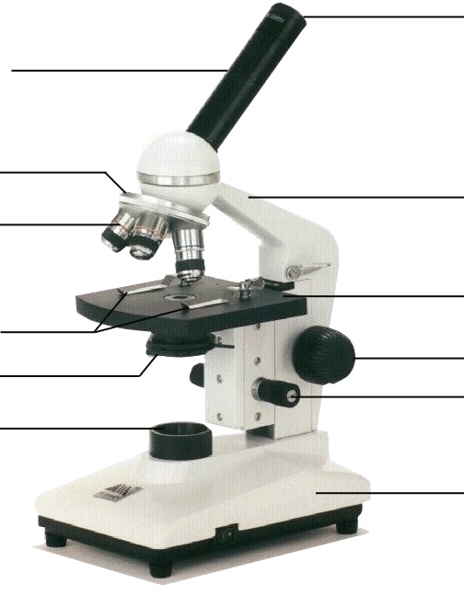
Compound Microscope
1. Eye Piece – lens closest to the eye.
2. Body Tube – gives distance between eyepiece and objective.
3. Nose Piece – holds the objectives.
4. Arm – holds the tube and lenses.
5. Objectives –
lens closest to the slide.
6. Stage – platform for the slides.
7. Stage clips –
Holds the slide in place.
8. Course Adjustment knob –
Moves stage up/down (to focus).
9. Diaphragm –
Controls the amount of light.
11. Light –
Shines light through the slide, lens, tube.
10. Fine Adjustment knob –
Moves stage up/down slightly
12. Base –
Holds up the entire microscope.

Slide 54
Using a Compound Microscope
Always carry the microscope by the base and the arm.
Keep the microscope in the center of the desk. (Stay away from the edge!)
Always start with the LOWEST power objective (the shortest one).
Place your slide on the stage. Try to center your specimen with the lens.
Start with the stage all the way up (so the objective and stage are closest together).
Turn on the light.

Slide 55
Using a Compound Microscope
Focus using the coarse adjustment knob first. Move the stage away from the objective lens until the image is in focus.
Once the slide is centered & in focus, then use the fine adjustment knob to sharpen the image.
Only, then may you switch to higher power objectives.
To calculate power of magnification:
Total magnification = Eyepiece x Objective
Total magnification = 10 x 4 = 40

Slide 56
Microscope Hints
Use the diaphragm to adjust the amount of light if the image is too dark.
Don’t focus by moving the stage and objective closer together – they may collide and smash the lens. Only focus by moving them away from one another!!!!
NEVER use the coarse adjustment knob when you are looking through the high power objective! Only use the fine adjustment knob.
Use only special lens paper to clean the lenses.
Don’t horseplay in the lab – these microscopes are expensive and break easily!!!

Slide 57
How to make a wet mount slide
Cut out an “e” from the paper and place it in the center of the slide.
Add 1 drop of water (not too much!)
Holding the cover slip gently, place one edge next to the drop of water.
Hold it a 45° angle and slowly lower.
There shouldn’t be any air bubbles or excess water.

Slide 58
After viewing slide
Take the stage down to its lowest position.
Turn the nosepiece so the lowest power objective lens is in place.
Remove the slide and place it safely to the side.
Turn off the light source.
Make sure the area is neat and orderly. All supplies should be ready for the next group.

Slide 59
Intro to Microscopes Lab
Stay in your seats! Raise your hand if you need to get up for any reason.
You must have the Microscope Quiz (100% correct) signed by me before you begin.
Start with Task 1. If you are waiting for a Microscope, begin Tasks 4, 5, or 6.
After everyone at your group is done Task 1, you may begin Task 2.
(*Save Task 3 for tomorrow.)
5) Keep your workstation neat & clean. Don’t spill any water and wipe the slides clean!

