Slide 1
Mar.4, 2019
You need:
Clean paper (2) / Pencil
Protist Web Adventure (3 completed)
Warm Up:
Mental Math – be ready.
I CAN: identify the properties of protists.

Slide 2
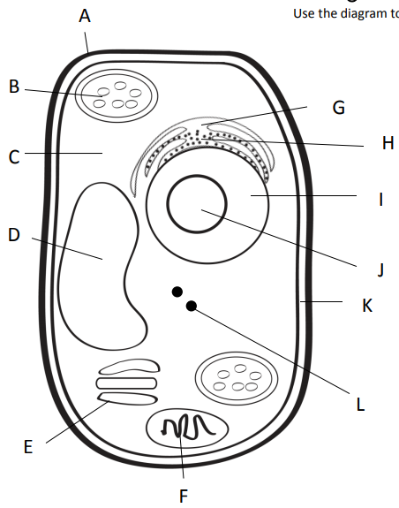
For Cane Cash
Outer most part of plant cell.
Makes food from sunlight
Road (smooth)
Road (rough)
Gel surrounding all
Controls cell
Storage
Copies ribosomes
Inner part of outer covering of plant cell.
Protein factory
Packaging plant
Power factory

Slide 3
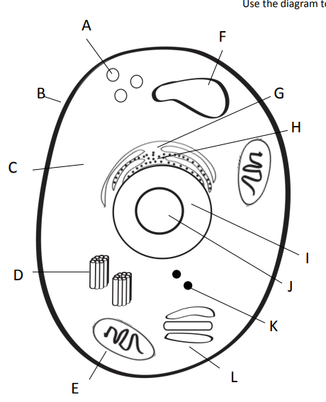
For Cane Cash
Clean up (pac-man)
Storage
Outer covering of an animal cell.
Road (smooth)
Road (rough)
Gel surrounding all
Controls cell
Copies ribosomes
Centrioles = help in cell division (reproduction)
Protein factory
Power factory
Packaging plant

Slide 4
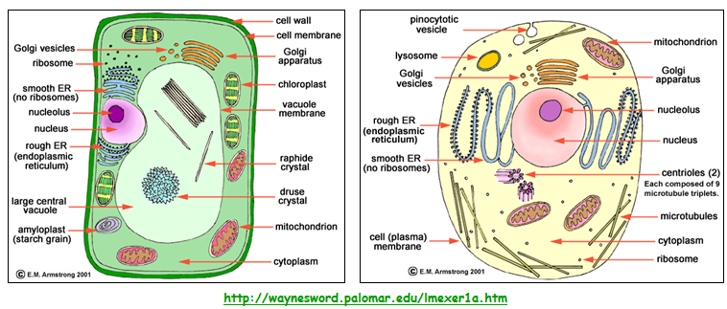
CELLS

Slide 5
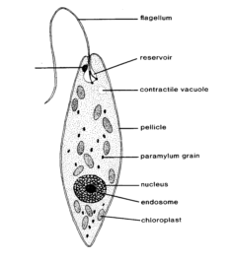
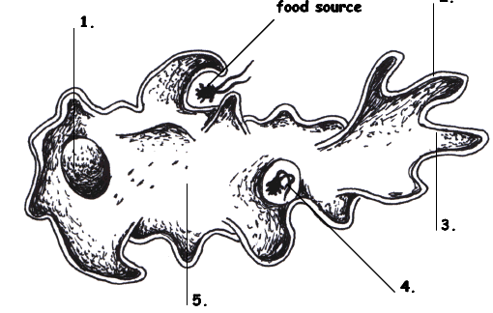
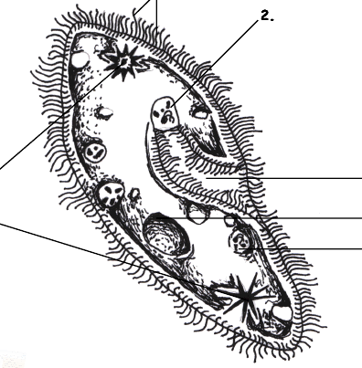
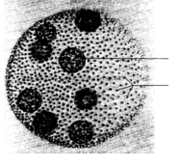
Protists…
Euglena, Amoeba,
Paramecium, and Volvox
Amoeba Sisters video

Slide 6
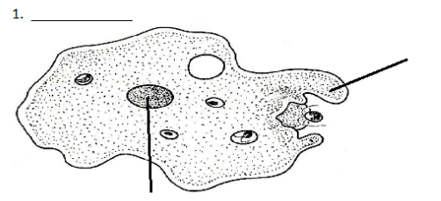
Amoeba
Amoeba
Pseudopod (fake foot)
Nucleus

Slide 7
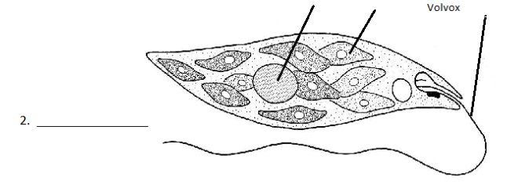
Euglena
Nucleus
Chloroplast
Flagella
Euglena

Slide 8
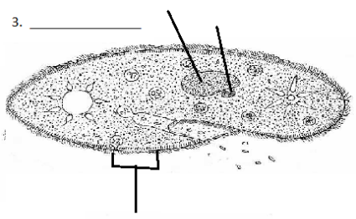
Paramecium
Macro (big) and micro (little) nucleus
Paramecium
Cilia

Slide 9
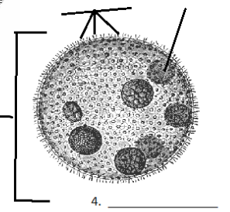
Volvox
Daughter colony
Adult Colony
Volvox

Slide 10
Species | Locomotion | Description (and sketch) | Autotroph or heterotroph | Reproduction
Amoeba
Paramecium
Euglena
Volvox

Slide 11
Protists…Animal? Plant? Fungus?
Protists are a mix of organisms that don’t exactly fit into the animal, plant, or fungus kingdoms…and sort of fits into all of them!
Protists are __________________ - which means they have a nucleus and other membrane bound organelles. The other category would be prokaryotic. What are we?
eukaryotes

Slide 12
Protists
Uni-cellular
____________________ - one celled organisms.
Some have animal – like qualities (_____________ means “first animal” in Greek)
Some have plant-like qualities like _______________
Some are like fungi
Protozoa
Chlorophyll to use in photosynthesis

Slide 13
Protists – finding food
Those who can feed themselves with photosynthesis are called ________________
Those who must find food in the environment around them (or move to find food) are called ________________________.
Autotrophs
Heterotrophs

Slide 14
Protists - locomotion
Some use a fake foot that they ooze outward to move, its called a … __________________
One example is the _____________________
Pseudopod
Amoeba

Slide 15
Protists - locomotion
Some have small, hair-like structures that come out of the membrane all over the organism… __________________
One example is the _____________________
Cilia
Paramecium

Slide 16
Protists - locomotion
Some use a whip-like tail known as a ____________________
One example of this is the __________________
Flagellum
Euglena

Slide 17
Protists - locomotion
Some work with each other – combining flagella and teamwork…
One example is the _____________________
Volvox

Slide 18
Amoeba
Some use a fake foot that they ooze outward to move, its called a … __________________
Single celled or ___________________
They must find food in the environment so they are ________________________________
They reproduce through _____________ which means they simply split into two cells.
Pseudopod
Uni-cellular
Heterotrophs
Fission
Amoeba Feeds! Youtube link

Slide 19
Paramecium
Some have small, hair-like structures that come out of the membrane all over the organism… __________________
Single-celled or ______________________
Collect food from the environment so they must be _____________________
Reproduce through ________________________
Cilia
Uni-cellular
Heterotrophs
Asexual means most often, but sexual reproduction is possible, too
Amazing Microscopic HD Video! Paramecium Feeding!

Slide 20
Euglena
Some use a whip-like tail known as a ____________________
Single celled or ______________________
Can either use photosynthesis OR collect food from the environment so a ________________
Reproduces through _____________________
Flagellum
Uni-cellular
Auto /
Heterotroph
Fission
EUGLENA: min 5:05 shows flagella fairly well

Slide 21
Volvox
Some work with each other – combining flagella and teamwork…
Volvox is actually many cells but each is an individual organism – they simply live together in a colony for the ease of life.
Contain chlorophyll so must be _______________ but can also collect NUTRIENTS from the environment so considered both ________________________________
Plant-like
Auto and heterotroph

Slide 22
Volvox
Each of the cells have two flagella and they must coordinate them to cause motion for the entire colony.
They have a red “eye” spot that can help determine light.
They work together but seem to have poles (so they know forward and back.
The volvox colony will reproduce new cells through asexual reproduction, but also has the ability to go to sexual reproduction so two separate colonies would be needed.
Volvox Dances!
Volvox – showing flagella

Slide 23
Protist Web Adventure
Name of Protist | Amoeba | Paramecium
Gets food
Digests food
Gets rid of waste
Moves
Oxygen
Reproduces
Surrounds the food
Uses cillia to help ingest food (“sweep” it in)
Also uses oral groove to catch food
Slowly brings it into the cell to digest
Digested by food vacuole
Waste exits through a vacuole.
Moves and leaves the waste behind.
Released through anal pore
Uses pseudopods
Cilia
Gets oxygen from water, soil, or other animals it lives on.
From the water that it lives in.
Through binary FISSION
Sexual and Asexual as needed. Asexual is most common.

Slide 24
Protist Web Adventure
Name of Protist | Euglena | Volvox
Gets food
Digests food
Gets rid of waste
Moves
Oxygen
Reproduces
Contains chloroplasts which have chlorophyll to produce their own food.
Can also move to food
Contains chlorophyll to produce its own food.
Can also move to find food – mostly algae
Store food in vacuoles
Digests by absorption through the cell surface (if outside source)
Through a vacuole
Using specialized cells?
Uses flagellum
Flagellum and teamwork
Gets oxygen from the fresh water or soil they live in.
From the water that it lives in.
Through binary FISSION
Sexual OR Asexual as needed

