Slide 1
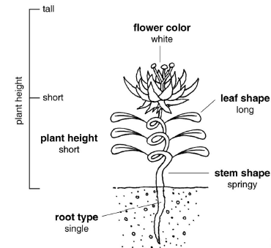
Mar. 19, 2019
You need:
Clean paper (2)/ pencil
Mendel notes
Warm Up:
Mental Math
I CAN: determine how/why traits are passed on to the next generation.

Slide 2
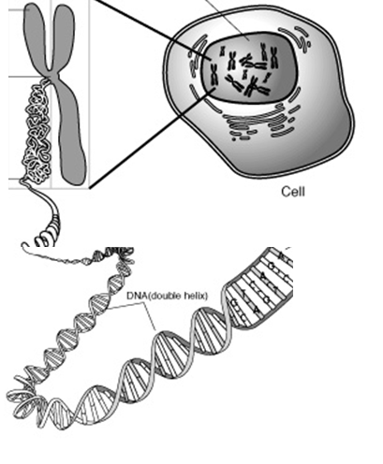
B.
Nucleus
C.
Chromosome
A.
CELL
D.
DNA
E.
A gene

Slide 3
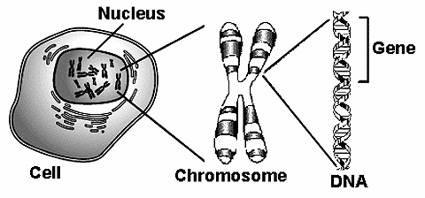

Slide 4
Vocabulary
Chromosomes – DNA wound into cute pkg
Genes – section of DNA/chromosome that codes for a specific trait
Traits – an organism’s physical features

Slide 5
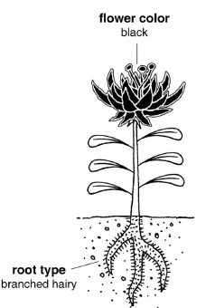

Slide 6
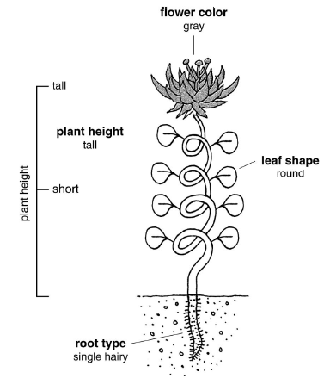
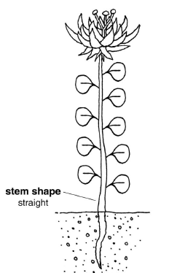

Slide 7
Describe the different features (and the possible forms of each feature).
For example, yesterday we talked about the alien head shape (feature) and how there were three possibilities = circle, vertical oval, horizontal oval (these are the forms of that feature).
Flower color = feature / trait
Forms = white or black or gray

Slide 8
Bead / gene
Trait
Long/thin leaf
Leaf shape
Short/round leaf

Slide 9
Yellow = leaf shape
What kind of leaves?
Long / thin
Green = plant height
If our plant has one gene coding for tall growth instructions and one gene coding for short growth instructions, what should our plant look like?
Move the green beads to the other pipe cleaner…now how does our plant look?

Slide 10
Bead / gene
Trait
VERSIONS or ALLELES
Long/thin leaf
Leaf shape
Short/round leaf
Tall
Plant height
Short
Notes:
I had to end here – we just did not make it further.

Slide 11
These genes code for flower color.
It comes in two forms = white or black.
What should this plant’s flowers look like?
Which color is DOMINANT?
Which color is recessive?
Our flowers will be GRAY…
We call that INCOMPLETE DOMINANCE (neither allele really “wins” – and yet they both do).

Slide 12
Bead / gene
Trait
Long/thin leaf
Leaf shape
Short/round leaf
Complete Dominance
Tall
Plant height
Short
White
Gray
Incomplete Dominance
Flower color
Black

Slide 13
Genotype
Phenotype
Genotype
Phenotype
Long / thin
Gray
Long / thin
Black
Short / round
White
Tall
Tall
Short

Slide 14
Stem shape
Stem shape is also on the small chromosome and is represented by purple beads.
Large, dark purple bead = spiral stem
Dominant? Recessive?
Small, light purple bead = straight stem
Dominant? Recessive?
If our plant has a spiral stem, what bead combinations
are possible?

Slide 15
Large bead / small bead
If the plant has a mixture of large beads and small beads, where should the beads go?
Does it really matter?
It does NOT matter – as long as you get one bead for a trait from each parent. For example, you must get a height bead from MOM and a height bead from DAD.

Slide 16
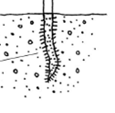
Root shape
Large, solid blue = branched hairy root
Large, clear blue = single, non-hairy root
Our plant is a single, hairy root.
What would its GENOTYPE be?
Genotype = the genes or alleles inside
Heterozygous = two different alleles

Slide 17
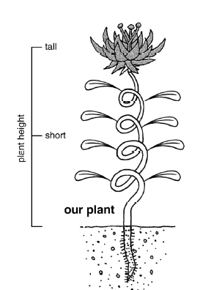
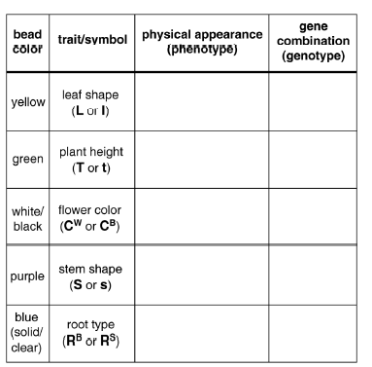
Together

Slide 18
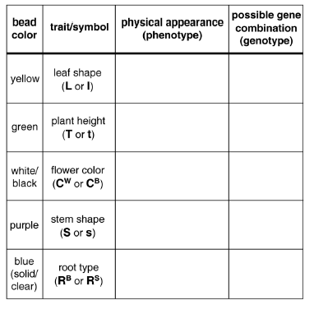
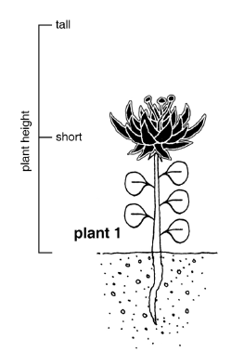
Together

Slide 19
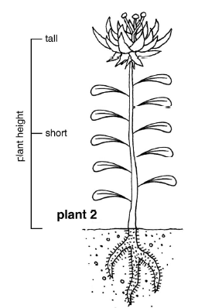
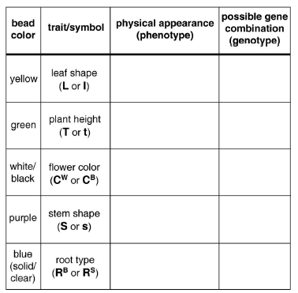
Independently

Slide 20
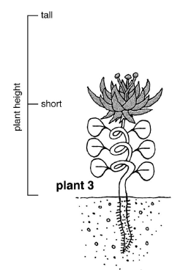
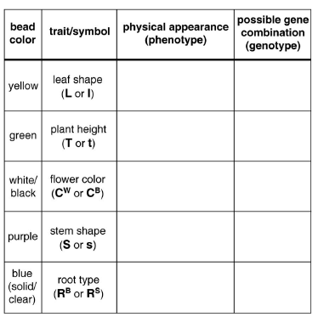
Independently

Slide 21
1
2
3
4

Slide 22
INDEPENDENT practice
On your own, choose any of the four alien plants shown and create the pipe cleaner/bead CHROMOSOME.
Give your newly made chromosome to the person across the table. Can they correctly determine which flower?
Return the chromosomes to their creator.

Slide 23
CLEAN UP
Be sure that all beads are off the pipe cleaner (GENTLY) and placed back in the proper boxes. If it falls on the floor – PICK IT UP!!
Pipe cleaners should be straightened back out.
Hand-outs on the table.
Your worksheet goes with you!

Slide 24
Long, thin
LL, Ll
Tall
TT, Tt
Gray
C^{W}C^{B}
Spiral
SS, Ss
Together
Single, hairy
R^{B}R^{S}

Slide 25
Together

Slide 26
Independently

Slide 27
Independently

Slide 28
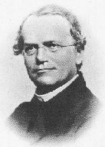
Mendel: Understanding Inheritance
Gregor Mendel
“The father of genetics”
1822-1864

Slide 29
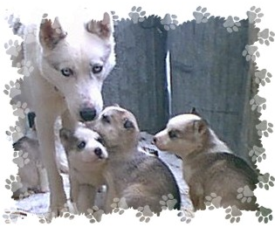
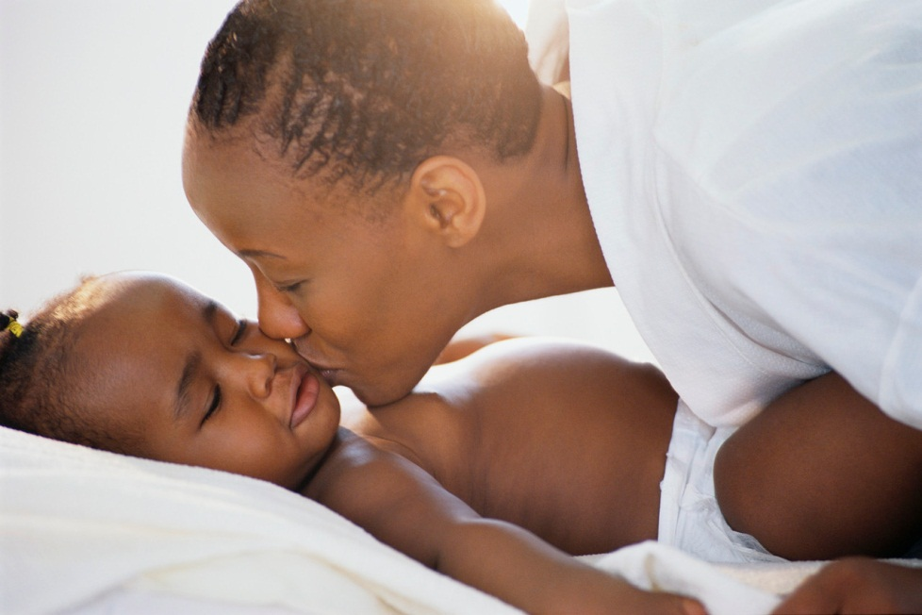
What is Genetics?
GENETICS - is the science of how traits are inherited. In other words, how traits pass from parent to offspring.

Slide 30
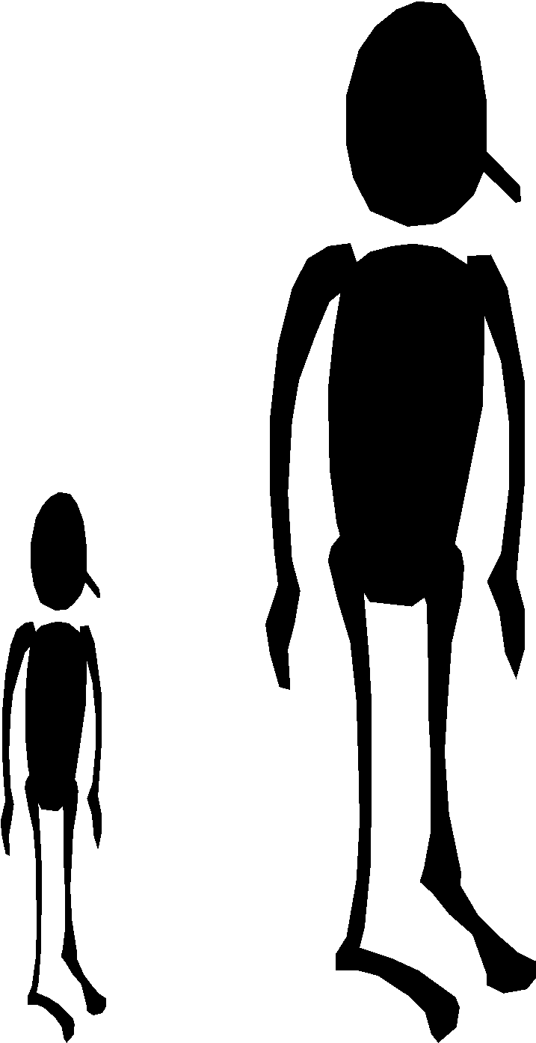
What are TRAITS?
TRAITS are characteristics (the way we look, are, or think).
For example, being tall or short, blond or dark-haired, brown eyes or blue eyes, light or dark skinned, funny or serious, etc…
Traits are genetic and are passed down from parent to offspring.

Slide 31
Have you ever wondered WHY you inherit certain traits from your parents?
Why do you have freckles, or dark hair, or blue eyes, or curly hair, or dimples, etc?
Gregor Mendel asked lots of questions about inheritance…

Slide 32
Who was Gregor Mendel?
Gregor Mendel was an Austrian monk, who lived in the 1800’s.
Mendel conducted thousands of experiments on pea plants to see how traits (shape, color) were passed from generation to generation.
Mendel is known as the “Father of Genetics” for figuring out the basic rules of how traits are inherited.

Slide 33
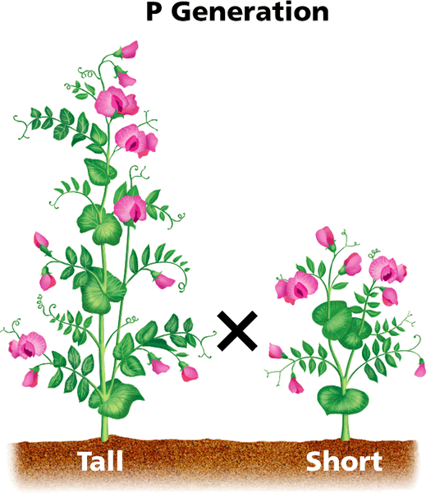
What type of experiments did Mendel do?
Mendel crossed pea plants with different traits (eg. tall & short).
He started with PUREBRED plants (showed same trait for many generations – short parents had short offspring)
He crossed a tall parent with a short parent to see what the offspring plants would look like.

Slide 34
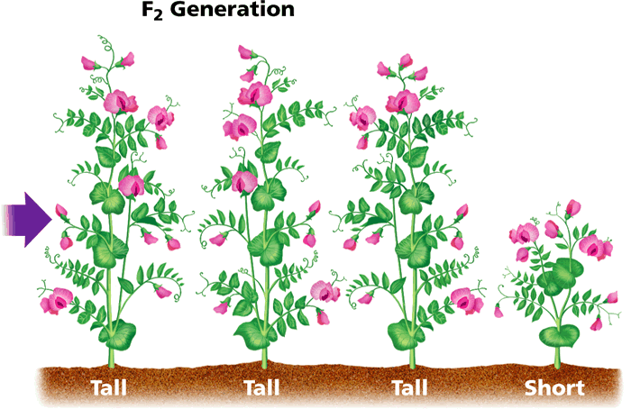
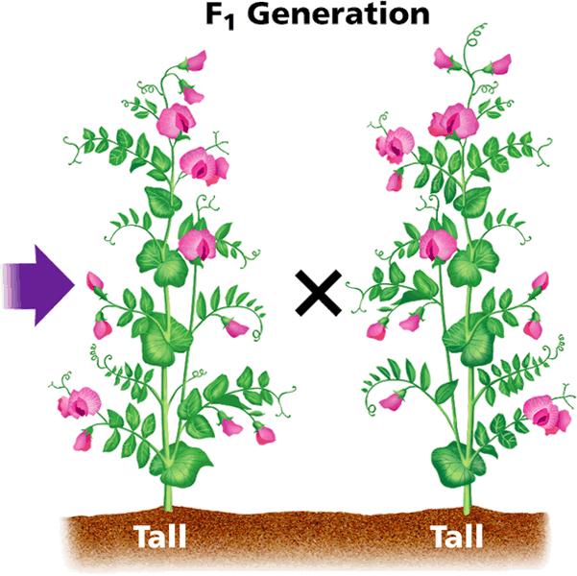
What happened?
The 1st generation of offspring were ALL tall!
The short trait was “lost” – it had disappeared.
In the 2nd generation, the “lost” short trait reappeared in ¼ of the offspring. (Even though neither parent was short!)

Slide 35
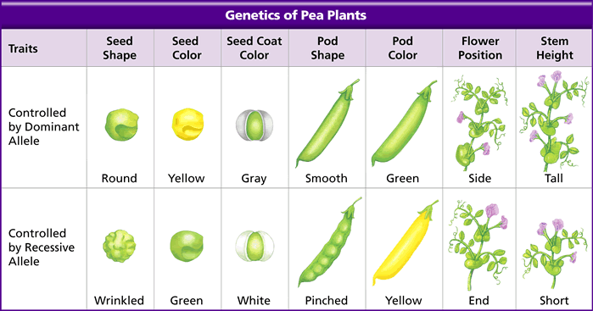
Mendel tested MANY traits – and found that one form of the trait was always “dominant” in the first generation of offspring, but that the “hidden” trait re-appeared in 25% of the second generation.

Slide 36
So, what are Mendel’s rules of inheritance?
Mendel figured out that:
Traits are controlled by PAIRS of “factors” (genes) that are inherited from your parents (one from mom, one from dad).
Some factors are “dominant” - they mask or hide the other factor.
(For example, the tallness gene hides the shortness gene in pea plants.)

Slide 37
Let’s get the new vocabulary straight…
GENES - are the factors that control an inherited trait.
ALLELES – are the different forms of a gene.
(the TALL and SHORT alleles are the 2 forms of the HEIGHT gene in pea plants)
*We inherit one allele (or form of a gene) from our mom and one allele from our dad, so we have 2 alleles for every gene.

Slide 38
Let’s get the new vocabulary straight…
DOMINANT ALLELE - is one whose trait always shows up when the allele is present.
It can mask or hide the other form of the trait.
It is shown with an upper-case letter, for example “T”.
Example: Tall stems = TT or Tt

Slide 39
Let’s get the new vocabulary straight…
RECESSIVE ALLELE – is one whose trait is hidden whenever the dominant allele is present.
It will only show up if BOTH alleles are recessive.
It is shown with a lower-case letter, for example “t”.
Example: Short stems = tt

Slide 40
Let’s get the new vocabulary straight…
TT
tt
HOMOZYGOUS - Organisms with 2 same alleles.
HETEROZYGOUS - Organisms with 2 different alleles.
Tt
Tt

Slide 41
Let’s review…
When you cross the tall and the short plant, the offspring get a Tall allele (T) from the tall plant and a short allele (t) from the short plant.
In the first generation, the dominant TALL allele hides the recessive SHORT allele, so ALL the offspring are tall.
They are all heterozygous.
TT
tt
Tt
Tt

Slide 42
What happens if heterozygous plants cross?
In the SECOND generation, the heterozygous plants cross and it’s possible to have an offspring with the 2 recessive alleles.
With 2 recessive alleles, the plant will be SHORT, not tall.
TT
tt
Tt
Tt
TT
Tt
Tt
tt

Slide 43
SUMMARY
When studying genetics, we need to take 2 things into account:
PHENOTYPE - an organism’s PHYSICAL appearance.
(3 plants are tall, 1 is short)
GENOTYPE – an organism’s
GENETIC makeup (alleles).
(1 plant is TT, 2 plants are Tt,
and 1 plant is tt)
TT
Tt
Tt
tt

Slide 44
Review and Move On
Vocabulary – Word Wall
Bikini Bottom

Slide 45
Bikini Bottom Genetics
Homozygous = two of the SAME alleles (letters/genes)
Heterozygous = two DIFFERENT alleles (letter/genes)
TT = _______
Dd= _______

Slide 46
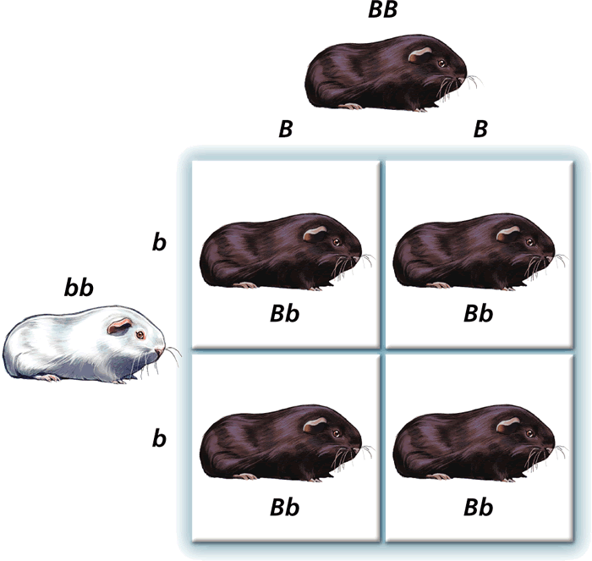
Probability & Heredity: Punnett Squares

Slide 47
How can we figure out which traits will be inherited?
To talk about inheritance, we need to use our new vocabulary…
We’ve learned about dominant & recessive alleles:
Dominant alleles are more powerful, and can “hide” a recessive trait.
Shown with an upper-case letter (“T” for tall stems)
Recessive alleles can be “hidden” when a dominant allele is present.
Shown with a lower-case letter (“t” for short stems)

Slide 48
How can we figure out which traits will be inherited?
You know the differences between genotype and phenotype:
Genotype describes which genes (alleles) are present.
TT = 2 dominant alleles
Tt = 1 dominant & 1 recessive
tt = 2 recessive alleles
Phenotype describes what the physical trait looks like.
Tall stems (TT and Tt)
Short stems (tt)

Slide 49
More vocabulary…
Geneticist use 2 terms to describe GENOTYPE:
Homozygous – the organism has 2 same alleles.
TT = 2 dominant alleles
tt = 2 recessive alleles
Heterozygous – the organism has 2 different alleles.
Tt = 1 dominant & 1 recessive allele

Slide 50
So, how do we know which genotype or phenotype the offspring will be?
We can use a tool called a punnett square to predict how likely it is for an offspring to inherit certain traits.
A PUNNETT SQUARE:
is a chart that shows ALL the possible combinations of a genetic cross.
shows genotype and phenotype of the offspring.
is also used to predict the probability (the chance) that an offspring will have a certain trait.

Slide 52
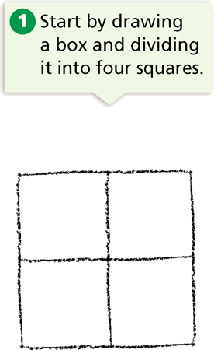
How do we draw a Punnett Square?

Slide 53
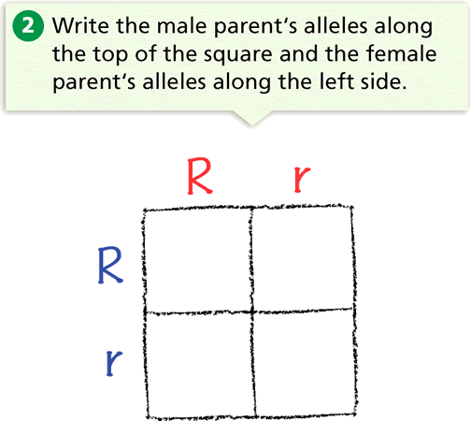
“R” is dominant for Round seeds.
“r” is recessive for wrinkled seeds.
Both parents are “heterozygous” and have round seeds.

Slide 54
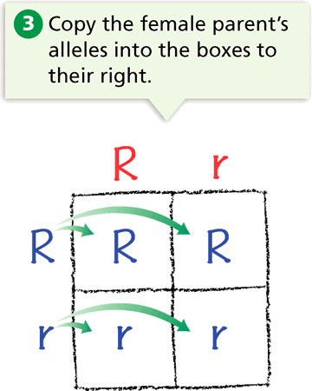

Slide 55
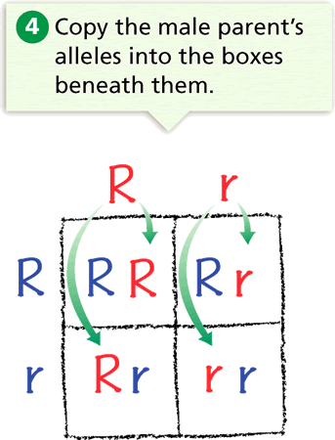

Slide 56
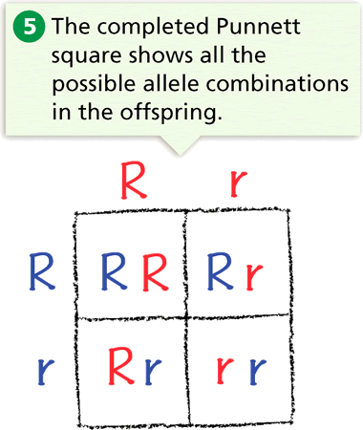

Slide 57
The two-letter combinations are the possible genotypes of the offspring.
They are RR, Rr, Rr, and rr genotypes.
From this it is possible to determine the “probability” (chance) that a seed will have:
a round seed phenotype (3/4 or 75%) OR
a wrinkled seed phenotype (1/4 or 25%)

Slide 58
Try one on your own…
Cross a homozygous guinea pig with black fur (BB) with a homozygous guinea pig with white fur (bb).
(Black fur is dominant over white fur).

Slide 59
Try one on your own…
Cross a homozygous guinea pig with black fur (BB) with a homozygous guinea pig with white fur (bb).
B
B
b
b

Slide 60
Try one on your own…
Cross a homozygous guinea pig with black fur (BB) with a homozygous guinea pig with white fur (bb).
B
B
B
B
B
B
b
b

Slide 61
Try one on your own…
Cross a homozygous guinea pig with black fur (BB) with a homozygous guinea pig with white fur (bb).
B
B
b
b
b
B
B
b
b
b
B
B

Slide 62
The result?
All 4 possible offspring will be heterozygous and have one dominant allele for black fur and 1 recessive allele for white fur.
All the guinea pigs will have the black fur phenotype; and Bb genotype.

Slide 63
More practice problems…
1) Cross a heterozygous tall pea plant (Tt) with a homozygous
short pea plant (tt).
Tall stems (T) are dominant over short stems (t).
What are the possible offspring from this cross?
2) Cross a rabbit who is heterozygous for short ears (Ee) with
another rabbit who is heterozygous for short ears (Ee).
Short ears (E) are dominant over long, floppy ears (e).
What are the possible offspring from this cross?

Slide 64
More practice problems…
Homework – Bikini Bottom Genetics!

Slide 65
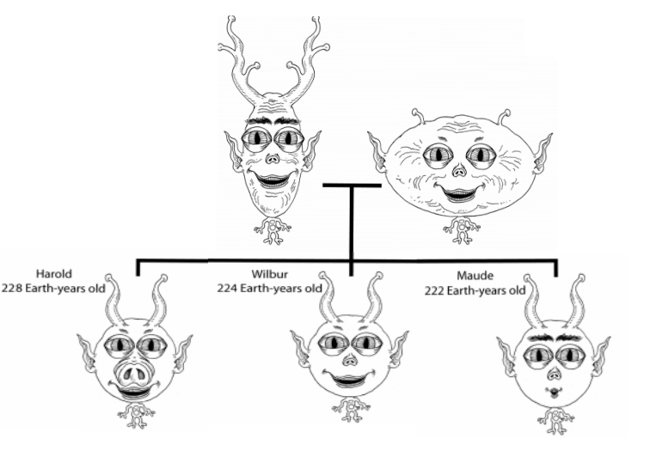

Slide 66
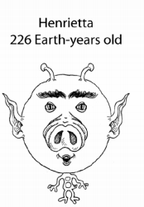
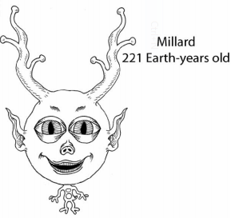

Slide 67
Omah and Opah

Slide 68
Omah and Opah
Omah
392 Earth years old
Opah
389 Earth years old

Slide 69
Omah and Opah
Omah
392 Earth years old
Opah
389 Earth years old

Slide 70
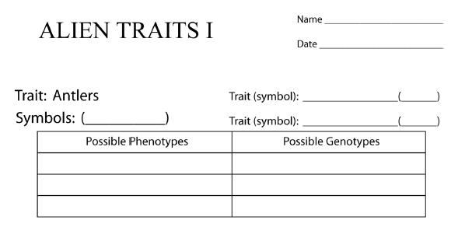
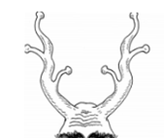
1. Large, branched
2. Short, not branched
3. Medium, not branched

Slide 71
1. Large, branched
2. Short, not branched
3. Medium, not branched
Since there are THREE ways for this to show, but only two genes…is one truly dominant over the other?
NO – they must mix or blend. We call this ________________
INCOMPLETE DOMINANCE

Slide 72
A^{B}
B – large, branched
A^{B}
A^{S}
A^{S}
S – short, not branched
1. Large, branched
A^{B}
A^{B}
2. Short, not branched
A^{S}
A^{S}
3. Medium, not branched
A^{B}
A^{S}

Slide 73
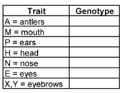
Omah and Opah
Omah
392 Earth years old
Opah
389 Earth years old
A^{B} A^{B}
A^{S} A^{S}
A^{B}A^{S}

Slide 74
Omah and Opah
Omah
392 Earth years old
Opah
389 Earth years old

Slide 76
Omah and Opah
Omah
392 Earth years old
Opah
389 Earth years old

Slide 77
Big mouth
M
M
m
Small mouth
m
Large
M
M
M
m
Small
m
m
ONLY two possibilities = so one is DOMINANT and the other is RECESSIVE!

Slide 79
Omah and Opah
Omah
392 Earth years old
Opah
389 Earth years old

Slide 80
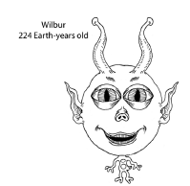
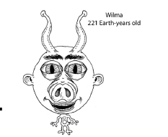
Possible phenotypes…
With Omah and Opah, they all look alike. But what about these?

Slide 81
Pointed
P
P and p
rounded
p
Pointed
p
P
P
P
p
rounded
p

Slide 82
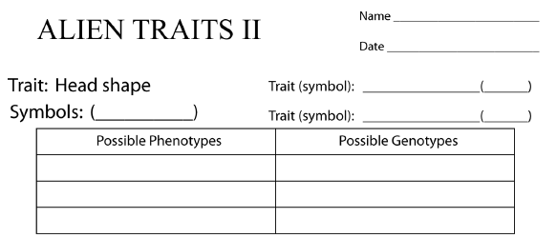
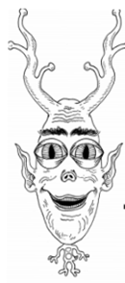
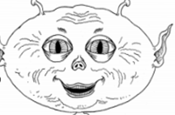
Narrow
H^{N} H^{W}
Wide
Narrow
Wide
INCOMPLETE DOMINANCE = blending

Slide 83
Omah and Opah
Omah
392 Earth years old
Opah
389 Earth years old

Slide 85
Omah and Opah
Omah
392 Earth years old
Opah
389 Earth years old

Slide 87
Omah and Opah
Omah
392 Earth years old
Opah
389 Earth years old

Slide 89
Review and vocabulary
Pedigree
Parent
Filial / offspring
Generations
Traits
Chromosomes
Dominant (gene)
Recessive (gene)
We will add more as we go.

