Slide 1
Mar.1, 2019
You need:
Clean paper (2) / Pencil
Protist Web Adventure (3 completed)
Warm Up:
Mental Math – be ready.
I CAN: identify the properties of protists.

Slide 2
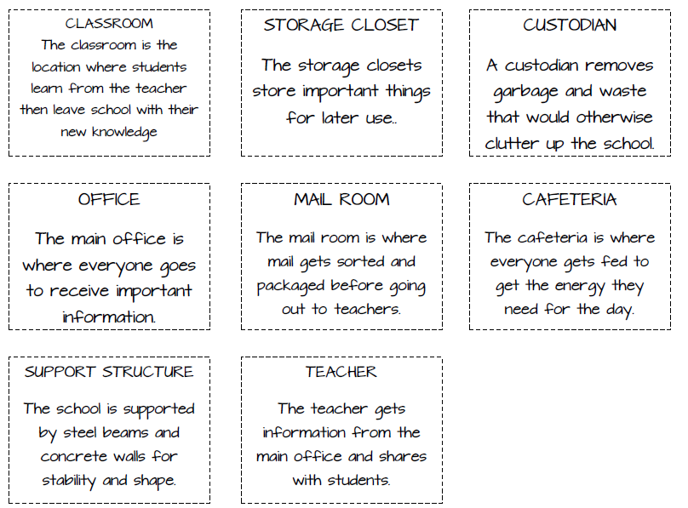
Endoplasmic Reticulum
Vacuole
Nucleus
Golgi Body
Mitochondria
Cytoskeleton/cytoplasm
Golgi Body

Slide 3
Parts of a cell
Remember that we compared the parts of a cell to a city? To a school?
Color the NAME the same color you choose to color in the organelle. For example, if you color in the word “nucleus” with blue, then also color in that portion of the cell in blue.

Slide 4
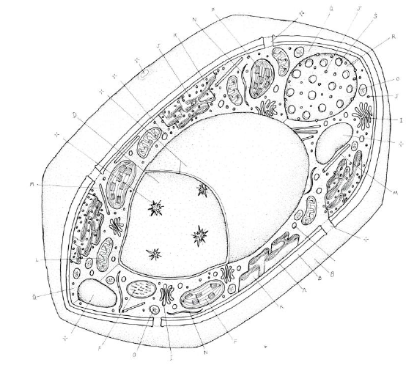
Plant Cell
K.
J.
D.
I.
L.
B.
A.
F.
F.

Slide 5
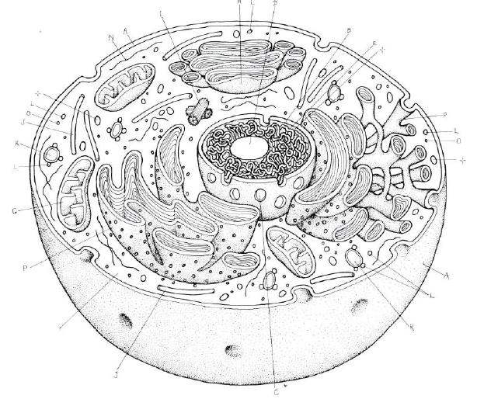
Animal Cell
A.
B.
E.
P.
K.
O.
G.
P.
A.
L.

Slide 6
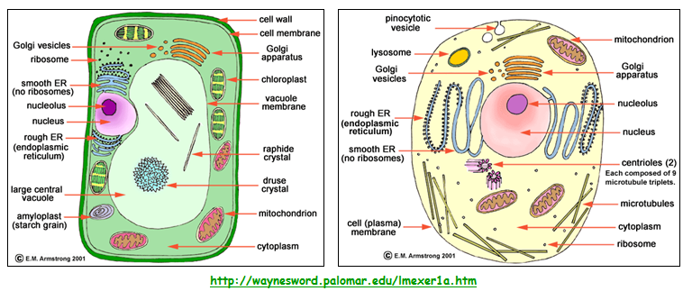
CELLS

Slide 7
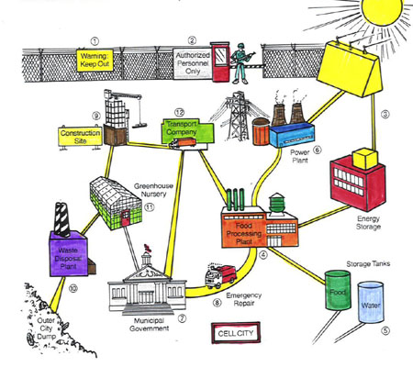
The Whole City…
Post Office

Slide 8
Plant Cell
K.
J.
D.
I.
L.
B.
A.
F.
F.

Slide 9
Animal Cell
A.
B.
E.
P.
K.
O.
G.
P.
A.
L.

Slide 10
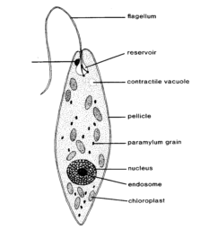
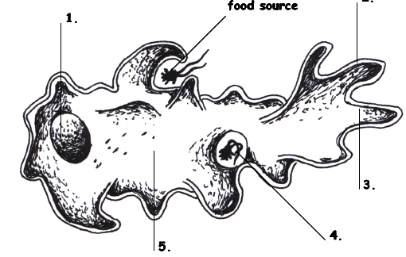
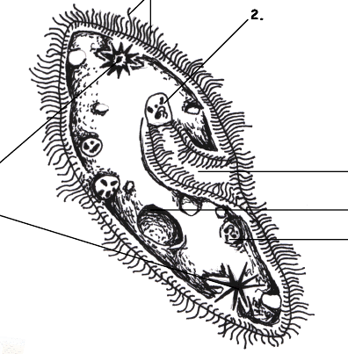
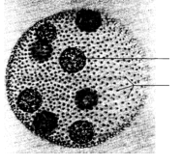
Protists…
Euglena, Amoeba,
Paramecium, and Volvox

Slide 11
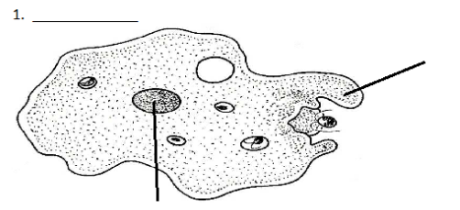
Amoeba
Amoeba
Pseudopod (fake foot)
Nucleus

Slide 12
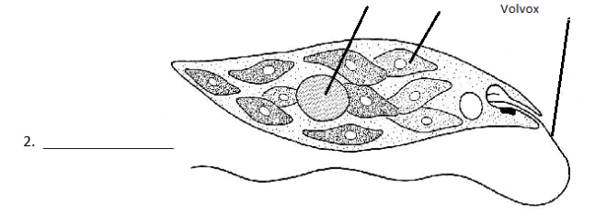
Euglena
Nucleus
Chloroplast
Flagella
Euglena

Slide 13
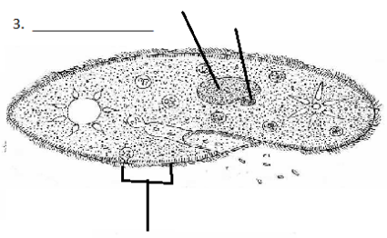
Paramecium
Macro (big) and micro (little) nucleus
Paramecium
Cilia

Slide 14
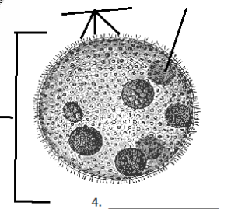
Volvox
Daughter colony
Adult Colony
Paramecium

Slide 15
Protists…Animal? Plant? Fungus?
Protists are a mix of organisms that don’t exactly fit into the animal, plant, or fungus kingdoms…and sort of fits into all of them!
Protists are __________________ - which means they have a nucleus and other membrane bound organelles. The other category would be prokaryotic. What are we?
eukaryotes

Slide 16
Protists
Uni-cellular
____________________ - one celled organisms.
Some have animal – like qualities (_____________ means “first animal” in Greek)
Some have plant-like qualities like _______________
Some are like fungi
Protozoa
Chlorophyll to use in photosynthesis

Slide 17
Protists – finding food
Those who can feed themselves with photosynthesis are called ________________
Those who must find food in the environment around them (or move to find food) are called ________________________.
Autotrophs
Heterotrophs

Slide 18
Protists - locomotion
Some use a fake foot that they ooze outward to move, its called a … __________________
One example is the _____________________
Pseudopod
Amoeba

Slide 19
Protists - locomotion
Some have small, hair-like structures that come out of the membrane all over the organism… __________________
One example is the _____________________
Cilia
Paramecium

Slide 20
Protists - locomotion
Some use a whip-like tail known as a ____________________
One example of this is the __________________
Flagellum
Euglena

Slide 21
Protists - locomotion
Some work with each other – combining flagella and teamwork…
One example is the _____________________
Volvox

Slide 22
Amoeba
Some use a fake foot that they ooze outward to move, its called a … __________________
Single celled or ___________________
They must find food in the environment so they are ________________________________
They reproduce through _____________ which means they simply split into two cells.
Pseudopod
Uni-cellular
Heterotrophs
Fission
Amoeba Feeds! Youtube link

Slide 23
Paramecium
Some have small, hair-like structures that come out of the membrane all over the organism… __________________
Single-celled or ______________________
Collect food from the environment so they must be _____________________
Reproduce through ________________________
Cilia
Uni-cellular
Heterotrophs
Asexual means most often, but sexual reproduction is possible, too
Amazing Microscopic HD Video! Paramecium Feeding!

Slide 24
Euglena
Some use a whip-like tail known as a ____________________
Single celled or ______________________
Can either use photosynthesis OR collect food from the environment so a ________________
Reproduces through _____________________
Flagellum
Uni-cellular
Auto /
Heterotroph
Fission
EUGLENA: min 5:05 shows flagella fairly well

Slide 25
Volvox
Some work with each other – combining flagella and teamwork…
Volvox is actually many cells but each is an individual organism – they simply live together in a colony for the ease of life.
Contain chlorophyll so must be _______________ but can also collect NUTRIENTS from the environment so considered both ________________________________
Plant-like
Auto and heterotroph

Slide 26
Volvox
Each of the cells have two flagella and they must coordinate them to cause motion for the entire colony.
They have a red “eye” spot that can help determine light.
They work together but seem to have poles (so they know forward and back.
The volvox colony will reproduce new cells through asexual reproduction, but also has the ability to go to sexual reproduction so two separate colonies would be needed.
Volvox Dances!
Volvox – showing flagella

Slide 27
Protist Web Adventure
Name of Protist | Amoeba | Paramecium
Gets food
Digests food
Gets rid of waste
Moves
Oxygen
Reproduces
Surrounds the food
Uses cillia to help ingest food (“sweep” it in)
Also uses oral groove to catch food
Slowly brings it into the cell to digest
Digested by food vacuole
Waste exits through a vacuole.
Moves and leaves the waste behind.
Released through anal pore
Uses pseudopods
Cilia
Gets oxygen from water, soil, or other animals it lives on.
From the water that it lives in.
Through binary FISSION
Sexual and Asexual as needed. Asexual is most common.

Slide 28
Protist Web Adventure
Name of Protist | Euglena | Volvox
Gets food
Digests food
Gets rid of waste
Moves
Oxygen
Reproduces
Contains chloroplasts which have chlorophyll to produce their own food.
Can also move to food
Contains chlorophyll to produce its own food.
Can also move to find food – mostly algae
Store food in vacuoles
Digests by absorption through the cell surface (if outside source)
Through a vacuole
Using specialized cells?
Uses flagellum
Flagellum and teamwork
Gets oxygen from the fresh water or soil they live in.
From the water that it lives in.
Through binary FISSION
Sexual OR Asexual as needed

