Slide 1
Feb. 28, 2019
You need:
Clean paper (2) / Pencil
Cell is Like a School project
Warm Up:
Mental Math – be ready
I CAN: start identifying protists.

Slide 2
CELLS
Even if cells are very tiny, they are made up of smaller parts, and the parts do different jobs.
Cell membrane
Nucleus

Slide 3
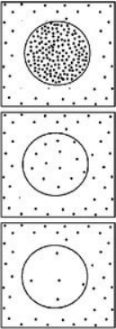
Osmosis – “osmos” is Greek…to push
Movement of WATER through a semi-permeable membrane…for balance.
Diffusion – mvmt of particles

Slide 4
Homeostasis
Homeo…homoios, homo
-Greek
-means “like” or “same/similar”
Stasis…
-English
-means a period of inactivity or balance

Slide 5
Cells
PROKARYOTIC and EUKARYOTIC
Has organelles, but they are not membrane-bound (kinda messy)
Has organelles that ARE membrane-bound (more neat and contained)
Bacteria
Plants
Protists
Animals

Slide 6
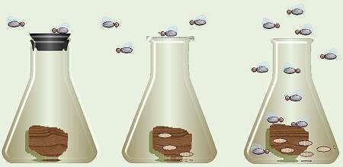
Francesco Redi – (1668)
People believed flies spontaneously came from meat… “Spontaneous Generation”
Redi covered one flask, left one open to air.
Observed flies laying eggs on meat.
Flies come from flies. Life comes from life.
Copyright © 2010 Ryan P. Murphy

Slide 7
Francesco Redi (1668)
Life comes from life.
Schleiden (1838)
Plants are made of cells…cells are basic building block of all plants.
Schwann (1839)
Animals are made of cells…cells are basic building block of all living things.
Virchow (1850)
Cells come from other living cells.

Slide 8
Robert Hooke (1665)
Used a COMPOUND microscope
Saw cork (dead plant cells)
Described the cell walls (boxes) as “CELLS”
Anton van Leeuvenhoek (1670)
Looked at pond water…living cells
Described the moving beings as “animal-cules”

Slide 9
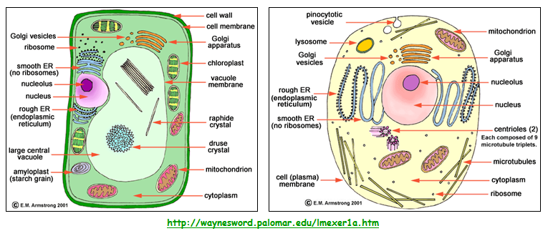
CELLS

Slide 10
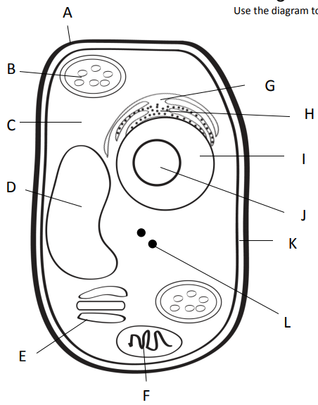

Slide 11
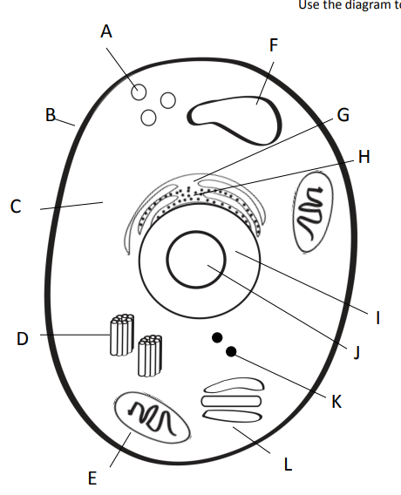

Slide 12
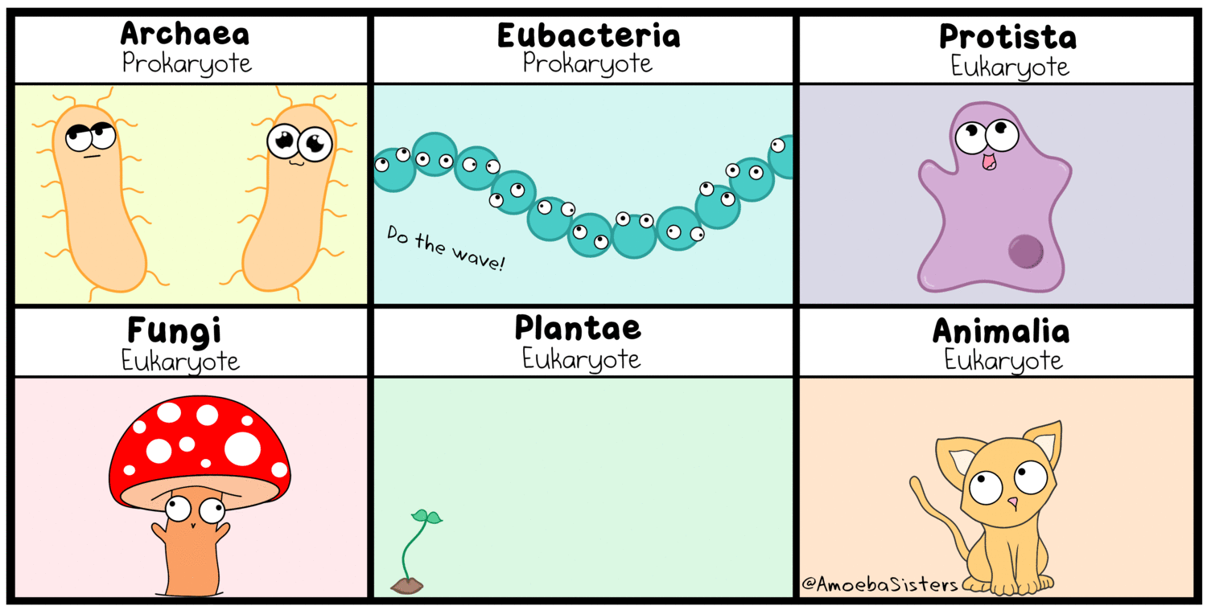

Slide 13
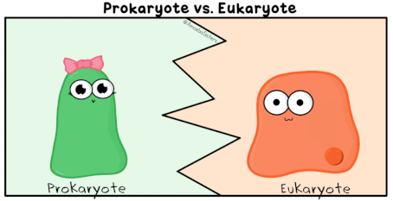

Slide 14
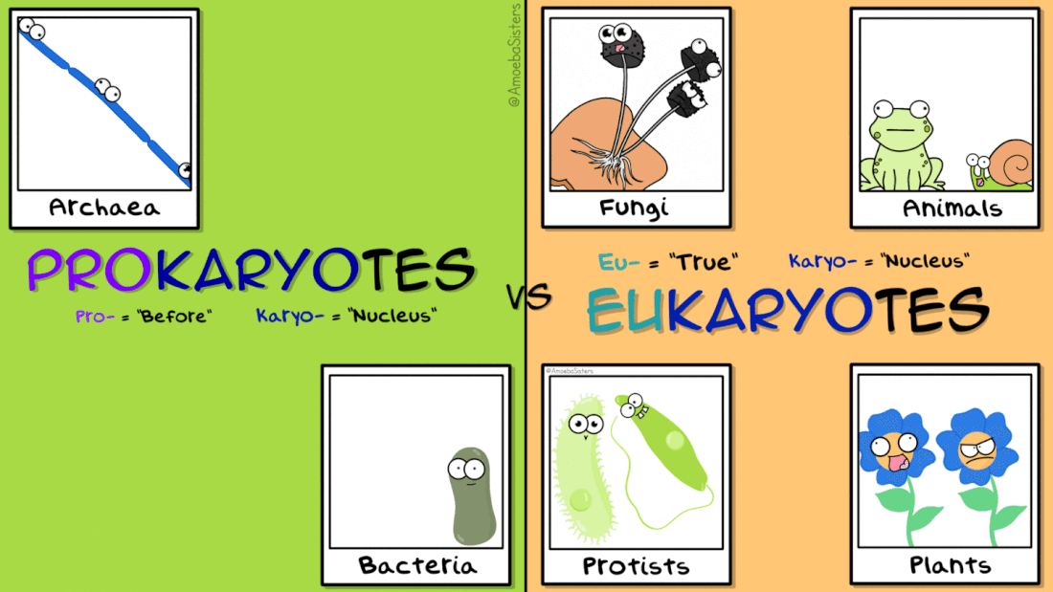

Slide 15
Today
A Cell is Like a School - turned in!!
Protist Web Adventure
You MAY work with ONE partner. You MUST finish the tasks assigned…and I reserve the right to stop a partnership if off-task.

Slide 16
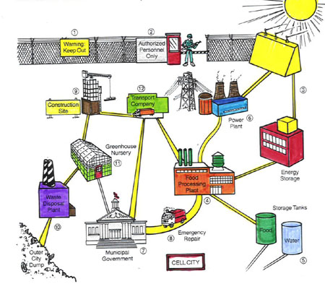
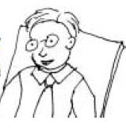
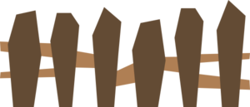
The Whole City…
1
2
12
3
9
6
11
Post Office
4
10
8
5
7

Slide 17
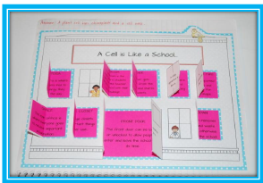

Slide 18
For those on computer…
Go to the Carrington website.
Find “Departments”
Click on the Hurricane team page.
Find Ms.Garris’s page…
Use the links provided to get started on your protist web quest.
You will find information on each of the four types of protists that we are studying.

Slide 19
https://www.enchantedlearning.com/subjects/protists/amoeba.shtml
https://www.mcwdn.org/Animals/Ameba.html
www.mcwdn.org/Animals/Paramecium.html
www.microscope-microscope.org/applications/pond-critters/protozoans/ciliphora/paramecium.htm
www.mcwdn.org/Animals/Euglena.html
https://www.britannica.com/science/Euglena

Slide 20
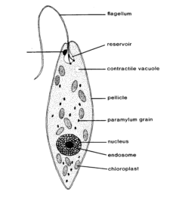
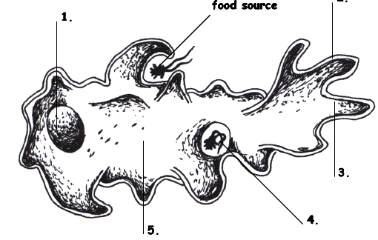
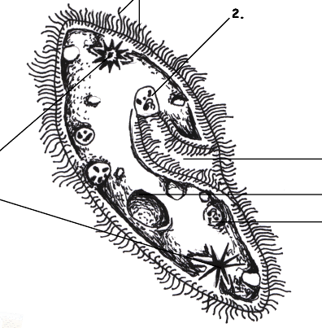
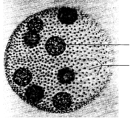
Protists…
Euglena, Amoeba,
Paramecium, and Volvox

Slide 21
Protists…Animal? Plant? Fungus?
Protists are a mix of organisms that don’t exactly fit into the animal, plant, or fungus kingdoms…and sort of fits into all of them!
Protists are __________________ - which means they have a nucleus and other membrane bound organelles. The other category would be prokaryotic. What are we?
eukaryotes

Slide 22
Protists
Uni-cellular
____________________ - one celled organisms.
Some have animal – like qualities (_____________ means “first animal” in Greek)
Some have plant-like qualities like _______________
Some are like fungi
Protozoa
Chlorophyll to use in photosynthesis

Slide 23
Protists – finding food
Those who can feed themselves with photosynthesis are called ________________
Those who must find food in the environment around them (or move to find food) are called ________________________.
Autotrophs
Heterotrophs

Slide 24
Protists - locomotion
Some use a fake foot that they ooze outward to move, its called a … __________________
One example is the _____________________
Pseudopod
Amoeba

Slide 25
Protists - locomotion
Some have small, hair-like structures that come out of the membrane all over the organism… __________________
One example is the _____________________
Cilia
Paramecium

Slide 26
Protists - locomotion
Some use a whip-like tail known as a ____________________
One example of this is the __________________
Flagellum
Euglena

Slide 27
Protists - locomotion
Some work with each other – combining flagella and teamwork…
One example is the _____________________
Volvox

Slide 28
Species | Locomotion | Description | Autotroph or heterotroph | Reproduction
Amoeba
Paramecium
Euglena
Volvox
Protist Notes WS –
Not the same as the
Protist Web Adventure.

Slide 29
Amoeba
Some use a fake foot that they ooze outward to move, its called a … __________________
Single celled or ___________________
They must find food in the environment so they are ________________________________
They reproduce through _____________ which means they simply split into two cells.
Pseudopod
Uni-cellular
Heterotrophs
Fission
Amoeba Feeds! Youtube link

Slide 30
Paramecium
Some have small, hair-like structures that come out of the membrane all over the organism… __________________
Single-celled or ______________________
Collect food from the environment so they must be _____________________
Reproduce through ________________________
Cilia
Uni-cellular
Heterotrophs
Asexual means most often, but sexual reproduction is possible, too
Amazing Microscopic HD Video! Paramecium Feeding!

Slide 31
Euglena
Some use a whip-like tail known as a ____________________
Single celled or ______________________
Can either use photosynthesis OR collect food from the environment so a ________________
Reproduces through _____________________
Flagellum
Uni-cellular
Heterotroph
Fission
Euglena
EUGLENA

Slide 32
Volvox
Some work with each other – combining flagella and teamwork…
Volvox is actually many cells but each is an individual organism – they simply live together in a colony for the ease of life.
Contain chlorophyll so must be _______________ but can also collect NUTRIENTS from the environment so considered both ________________________________
Plant-like
Auto and heterotroph

Slide 33
Volvox
Each of the cells have two flagella and they must coordinate them to cause motion for the entire colony.
They have a red “eye” spot that can help determine light.
They work together but seem to have poles (so they know forward and back.
The volvox colony will reproduce new cells through asexual reproduction, but also has the ability to go to sexual reproduction so two separate colonies would be needed.
Volvox Dances!

Slide 34
All of our protists…Review at this site!
http://www.harcourtschool.com/activity/science_up_close/602/deploy/interface.html

Slide 35
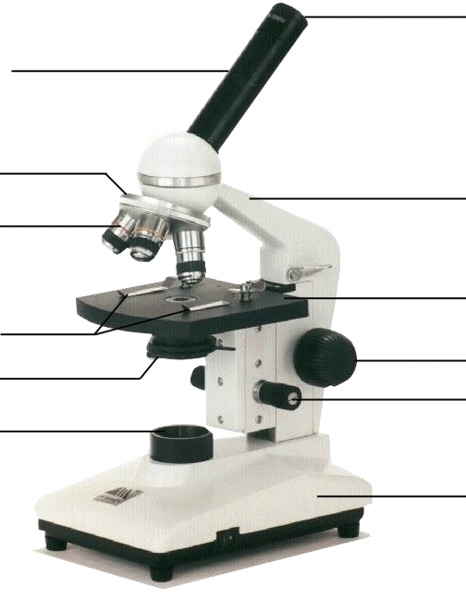
Compound Microscope
1. Eye Piece – lens closest to the eye.
2. Body Tube – gives distance between eyepiece and objective.
3. Nose Piece – holds the objectives.
4. Arm – holds the tube and lenses.
5. Objective lenses –
lens closest to the slide.
6. Stage – platform for the slides.
7. Stage clips –
Holds the slide in place.
8. Coarse Adjustment knob –
Moves stage up/down (to focus).
9. Diaphragm / IRIS –
Controls the amount of light.
11. Light –
Shines light through the slide, lens, tube.
10. Fine Adjustment knob –
Moves stage up/down slightly
12. Base – Holds up the entire microscope.

