Slide 1
Feb.22, 2019
You need:
Clean paper / pencil
Hypothesis and Cell coloring WS
Mental Math for Warm Up – be ready!
Warm Up:
I will say each MENTAL math problem two times…and only two times. Do NOT write anything but your answer – everything else is MENTAL!
I CAN: begin our study of the cell and the microscope.

Slide 2
Mental Math – NO TALKING!
Remember – you ONLY write the answer, not the problem or calculations. Each problem will be SAID two times…and only two. If you speak out of turn, you may not hear – and risk a zero.

Slide 3
Today’s checklist:
Mental math – and collect for the week.
Egg hypothesis – what will happen if we…?
Review plant cell coloring.
Add plant cell organelle grid – during class.
HW: Finish all of above AND coloring in of the animal cell.

Slide 4
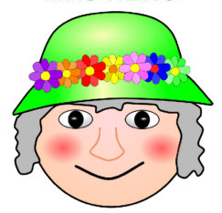
MRS. NERG-C
The list of characteristics something MUST have to be considered LIVING!
Movement
Respiration
Sensory
Nutrients (6)
Excretion
Reproduction
Growth
Cells

Slide 5
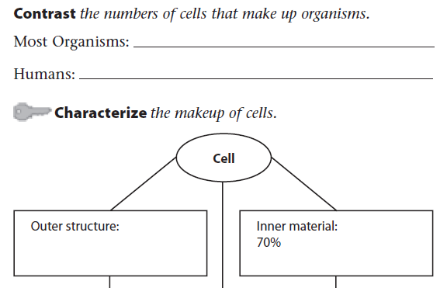
Just one…or few
Trillions!!
Cell membrane
Cell wall
water
organelles

Slide 6
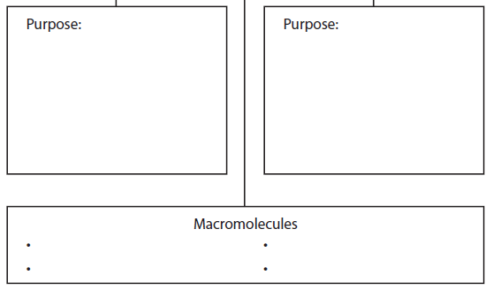
Support
Protection (filters)
Organization
Life activities:
Gas exchange
Food/energy
Waste management
Nucleic acids
proteins
Lipids (like fats)
carbohydrates

Slide 7
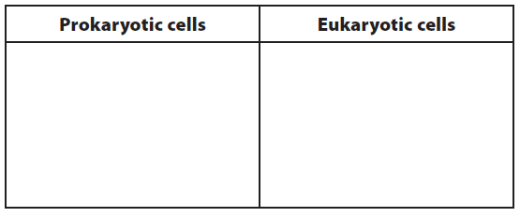
Do NOT have a nucleus and other
membrane-bound organelles…disorganized
Have a nucleus and other
membrane-bound organelles.

Slide 8
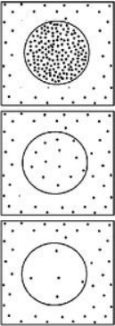
Osmosis – “osmos” is Greek…to push
Movement of WATER through a semi-permeable membrane…for balance.
Diffusion – mvmt of particles

Slide 9
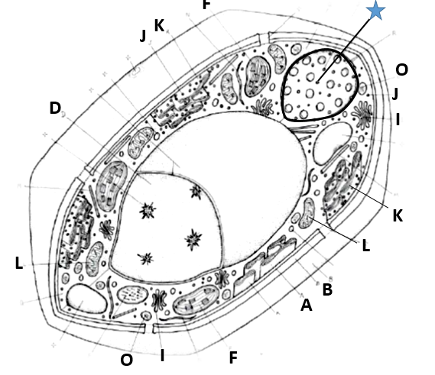

Slide 10
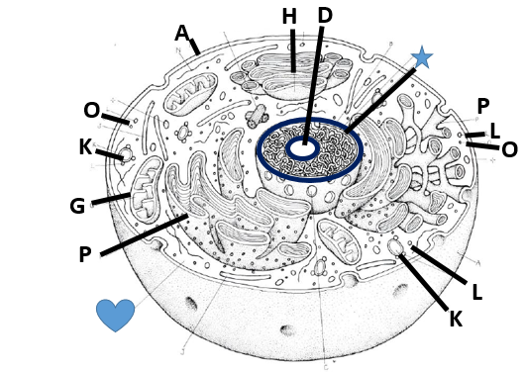

Slide 11
Eggs – let’s egg-speriment!!!
What will happen to the egg if…?
Write what you think will happen to the egg’s:
Color
Shape
Size
Texture/feel
weight

Slide 12
Egg | Water | Corn syrup | Blue paint | Blue food color
Color
Shape
Size
Texture/feel
weight
Write your hypothesis!

Slide 13
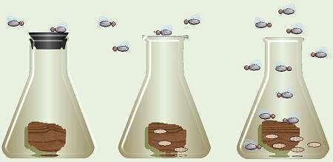
Francesco Redi – (1668)
People believed flies spontaneously came from meat… “Spontaneous Generation”
Redi covered one flask, left one open to air.
Observed flies laying eggs on meat.
Flies come from flies. Life comes from life.
Copyright © 2010 Ryan P. Murphy

Slide 14
Francesco Redi (1668)
Life comes from life.
Schleiden (1838)
Plants are made of cells…cells are basic building block of all plants.
Schwann (1839)
Animals are made of cells…cells are basic building block of all living things.
Virchow (1850)
Cells come from other living cells.

Slide 15
Robert Hooke (1665)
Used a COMPOUND microscope
Saw cork (dead plant cells)
Described the cell walls (boxes) as “CELLS”
Anton van Leeuvenhoek (1670)
Looked at pond water…living cells
Described the moving beings as “animal-cules”

Slide 16
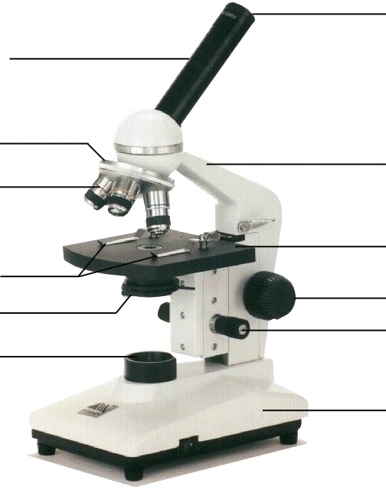
Compound Microscope
1. Eye Piece – lens closest to the eye.
2. Body Tube – gives distance between eyepiece and objective.
3. Nose Piece – holds the objectives.
4. Arm – holds the tube and lenses.
5. Objective lenses –
lens closest to the slide.
6. Stage – platform for the slides.
7. Stage clips –
Holds the slide in place.
8. Coarse Adjustment knob –
Moves stage up/down (to focus).
9. Diaphragm / IRIS –
Controls the amount of light.
11. Light –
Shines light through the slide, lens, tube.
10. Fine Adjustment knob –
Moves stage up/down slightly
12. Base – Holds up the entire microscope.

Slide 17
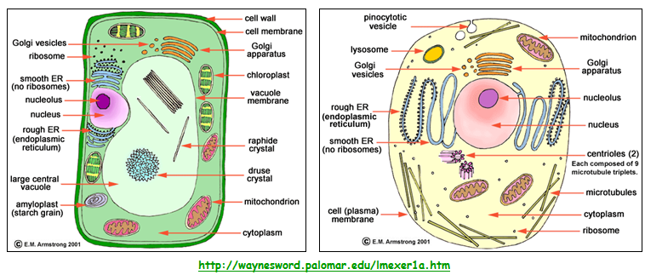
CELLS

Slide 18
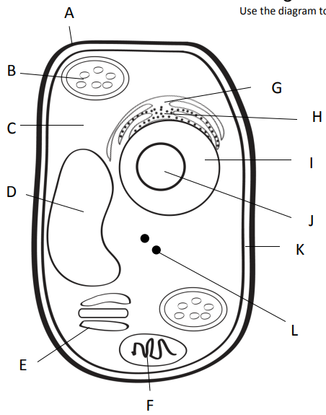
Outer most part of plant cell.
Makes food from sunlight
Road (smooth)
Road (rough)
Gel surrounding all
Controls cell
Storage
Copies ribosomes
Inner part of outer covering of plant cell.
Protein factory
Packaging plant
Power factory

Slide 19
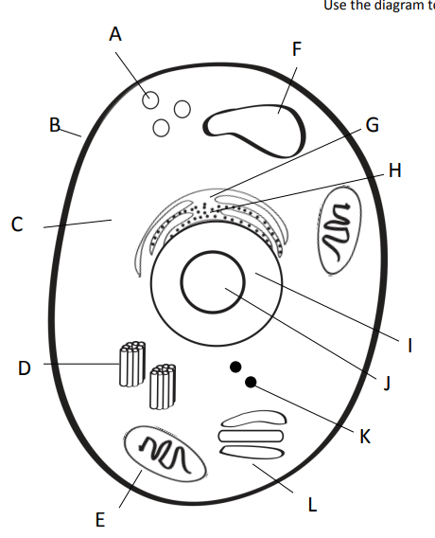

Slide 20
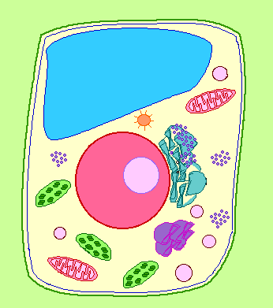
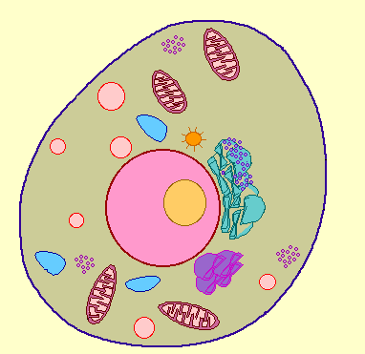
Cell Membrane
BOTH Plant and Animal Cells
Function: controls what substances enter and exit the cell
Analogy to City: City “Gate Keeper”

Slide 21
Cell Wall
PLANT CELLS ONLY
Function: surrounds plants to protect and support the cell
Analogy to City: City Border

Slide 22
Nucleus
BOTH Plant and Animal Cells
Function: directs all the cells activities (brain of cell)
Analogy to City: City Hall

Slide 23
Nucleolus
BOTH Plant and Animal Cells
Function: makes ribosomes inside the nucleus
Analogy to City: Copy Machine Inside City Hall

Slide 24
Nuclear Membrane
BOTH Plant and Animal Cells
Function: controls what enters and leaves the nucleus, protects
Analogy to City: gate around City Hall

Slide 25
Chromosomes
BOTH Plant and Animal Cells
Function: contains the important blueprints of the cell or DNA
Analogy to City: City Mayor

Slide 26
Vacuole
BOTH Plant and Animal Cells
Function: stores food, water, waste, and other materials
Analogy to City: Warehouses, Water Towers, etc.

Slide 27
Chloroplast
PLANT CELLS ONLY
Function: captures energy from sunlight and produces food
Analogy to City: Solar Energy Plant

Slide 28
Endoplasmic Reticulum
BOTH Plant and Animal Cells
Function: built proteins and move them throughout cell or out of cell (Smooth – no ribosomes, Rough – ribosomes)
Analogy to City: City Transportation Department

Slide 29
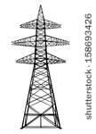
Cytoplasm
BOTH Plant and Animal Cells
Function: gel-like fluid between cell membrane and nucleus, allows other organelles to float freely through cell
Analogy to City: City Yards

Slide 30
Ribosomes
BOTH Plant and Animal Cells
Function: produce proteins
Analogy to City: Construction Company

Slide 31
Lysosomes
ANIMAL CELLS ONLY
Function: contain chemicals that break down food particles and worn out cell parts
Analogy to City: Recycle or Waste Management Company

Slide 32
Mitochondria
BOTH Plant and Animal Cells
Function: rod-shaped organelle that produce energy (powerhouse)
Analogy to City: Energy Plant

Slide 33
Golgi Body
BOTH Plant and Animal Cells
Function: receives materials from the endoplasmic reticulum and sends them to other parts of the cell
Analogy to City: Post Office
Post Office

Slide 34
The Whole City…
Post Office

Slide 35
1. Choose the wrong statement from the following.
a) Mitochondria produces most of the energy for the cell.
b) Chloroplasts are “food producers.”
c) Cell wall controls the movements of materials into and out of the cell.
d) Nucleus regulates and controls all cell activities, acting as the “brain” of the cell.

Slide 36
2. Match the cell part to the nickname.
1) Cytoplasm
2) Nuclear membrane
3) Vacuoles
a. Gate of the nucleus
b. Area of movement where cell parts move
c. Storage tanks

Slide 37
School analogy
Cut the doors/windows – just three sides.
Put the schoolhouse onto colorful paper and trace the box space.
Remove the schoolhouse and cut out the square place descriptions.
Determine where each square goes – and then glue!
Put schoolhouse over top and glue.

Slide 38
