Slide 1
Feb. 13, 2019
You need:
Clean paper (2) / Pencil
Warm up – MENTAL MATH ready
Nervous/Endocrine notes
Warm Up:
Mental Math – on warm up. Be ready.
I CAN: review the parts, function, care, and interaction of the systems studied…demonstrate knowledge.

Slide 2
Mental Math – NO TALKING!
Remember – you ONLY write the answer, not the problem or calculations. Each problem will be shown on screen for only a short time.

Slide 3
Mental Math – NO TALKING!
1.) 28 x 2 = ______

Slide 4
Mental Math – NO TALKING!
2.) $1.50 + $2.75 = ______

Slide 5
Mental Math – NO TALKING!
3.) 14 - 23 = ______

Slide 6
Mental Math – NO TALKING!
4.) 13 x 4 = ______

Slide 7
Mental Math – NO TALKING!
5.) 100 divided by 5 = ______

Slide 8
Mental Math-
Normally, we would trade and grade. We will NOT do that today.
Be sure to have your name on the paper, though – and the DATE…FEB.13, 2019

Slide 9
Let’s review!
We SHOULD know the parts, function, and care of each system.
Digestive, Excretory, Circulatory, and now Respiratory.
Raise your HAND – not your VOICE – to share each.

Slide 10
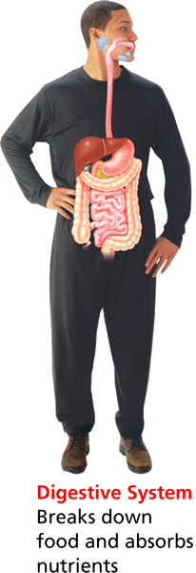
The Digestive System
Review
The digestive system has 3 main functions:
It breaks down food into particles that the body can use.
It absorbs nutrients into the blood.
It eliminates waste from the body.
Mouth
Esophagus

Slide 11
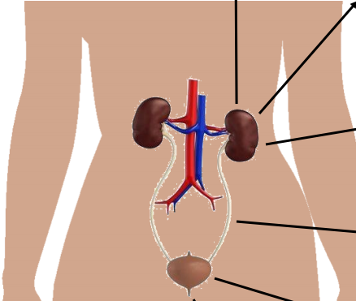
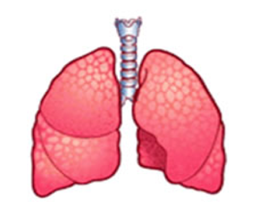
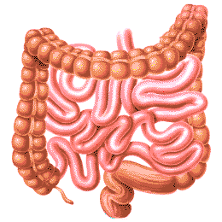
The Excretory system
Review
Eliminates waste from the body.

Slide 12
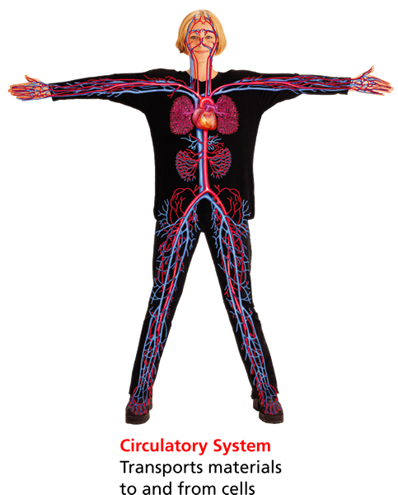
What does it do for us?
Review
Our circulatory system…
Delivers necessary materials (like oxygen and sugar) to the entire body in the blood,
Removes waste products from cells, and
Helps fight disease by transporting immune cells in the blood.

Slide 13
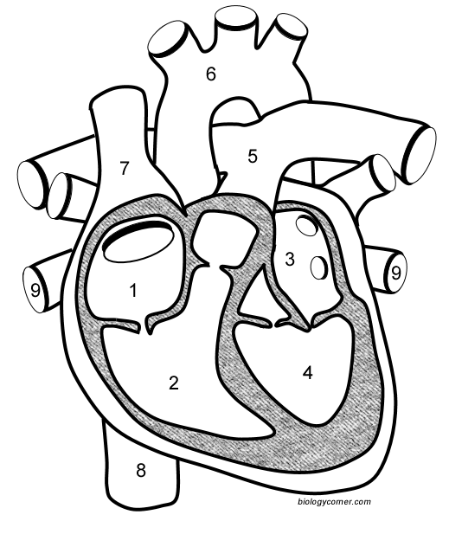
Heart labels
Review
Sup. Vena Cava
AORTA
To LUNGS
To LUNGS
Right
atrium
Left
Atrium
From LUNGS
From LUNGS
Right
Ventricle
Left
Ventricle
Inf. Vena Cava

Slide 14
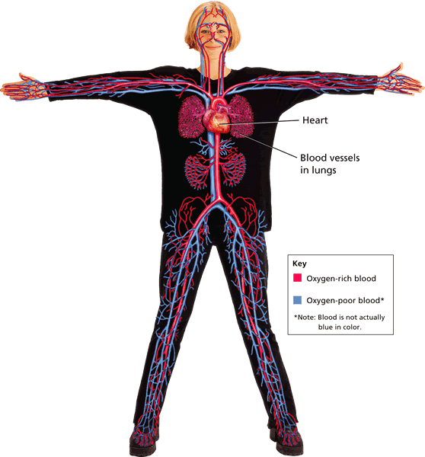
What carries the blood?
Review
BLOOD VESSELS are the hollow tubes that carry your blood around your body.
There are 3 TYPES:
ARTERIES
CAPILLARIES
VEINS

Slide 15
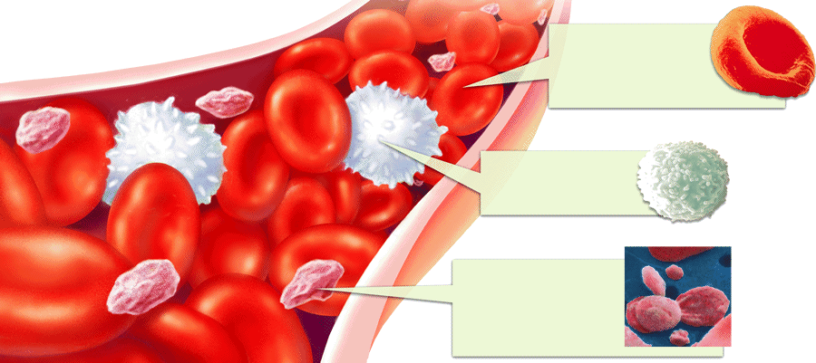
What is your blood?
Review
Red Blood Cells carry oxygen.
White blood cells fight disease.
Platelets form blood clots to stop you from bleeding too much.

Slide 16
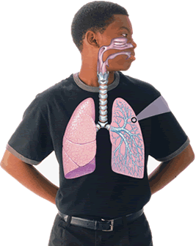
What is the RESPIRATORY SYSTEM?
- Breathe in and out…
Review
The system of the body that deals with BREATHING.
It consists of the NOSE, PHARYNX, TRACHEA, BRONCHIAL TUBES, and LUNGS.

Slide 17
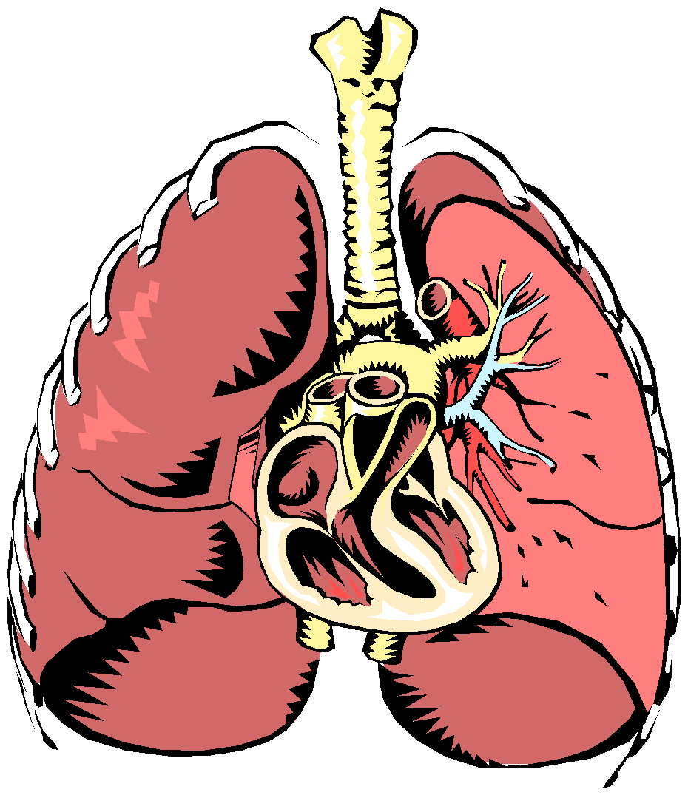
What is the FUNCTION of the Respiratory System?
- Breathe in and out…
Review
To DELIVER OXYGEN to the body.
To REMOVE CARBON DIOXIDE from the body.

Slide 18
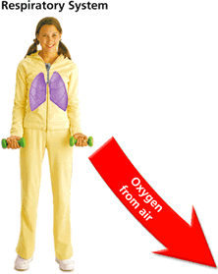
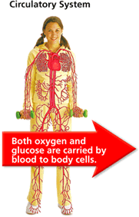
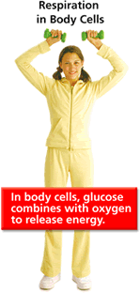
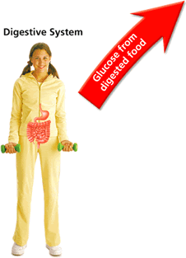
Which systems work together?
- Breathe in and out…
Review
RESPIRATORY SYSTEM gets OXYGEN from the air.
DIGESTIVE SYSTEM gets GLUCOSE from food.
CIRCULATORY SYSTEM DELIVERS oxygen and glucose to cells.
In the cells, respiration uses glucose and oxygen to release ENERGY.

Slide 19
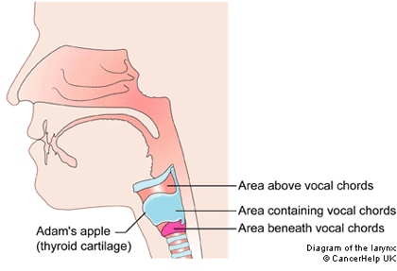
How are BREATHING & SPEAKING related?
Review
Air that you BREATHE OUT when you exhale also helps you SPEAK.
Your LARYNX is your VOICE BOX which has 2
VOCAL CHORDS that move and
produce sound when air passes
through the opening between
them.
Larynx

Slide 20
Quiz – Dig./Exc./Circ./Resp.
Questions are a class copy.
Answers go on the answer sheet.
You MAY use your notes – but not your neighbor. (Is there a lesson in that?)
Remember, if you use all of your time LOOKING for the answer in notes, you will not have time to finish the quiz. No extra time given!
When you finish, cover your paper and sit quietly.

Slide 21
After quiz
All question pages will go back to the folder on each lab table. (Red table has a red folder).
The ANSWER scan-tron will need to be turned into the basket. Be sure to put your name on it before turning it in.
When finished with quiz, review yesterday’s Nervous/Endocrine notes by filling in the Human Body Systems Chart (pg.2) with nervous/endocrine information.

Slide 22
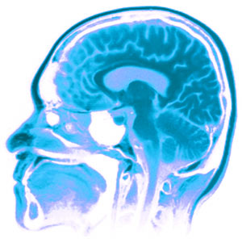
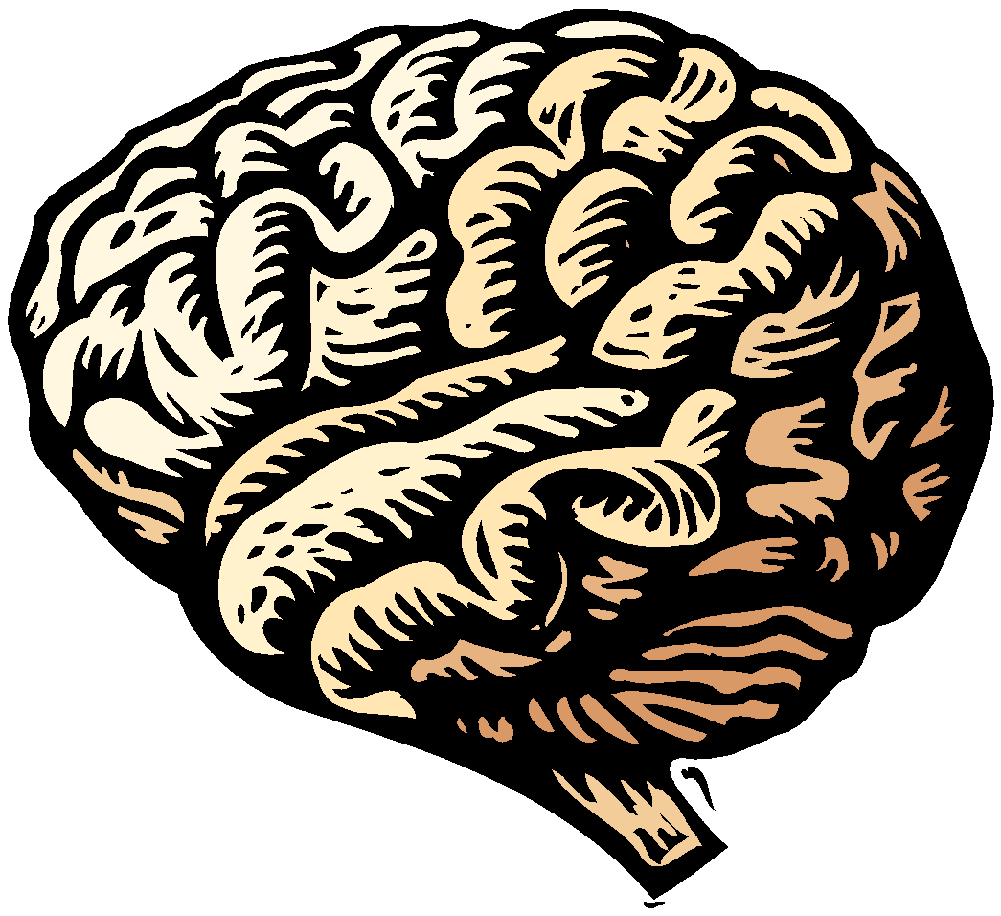
The Nervous System

Slide 23
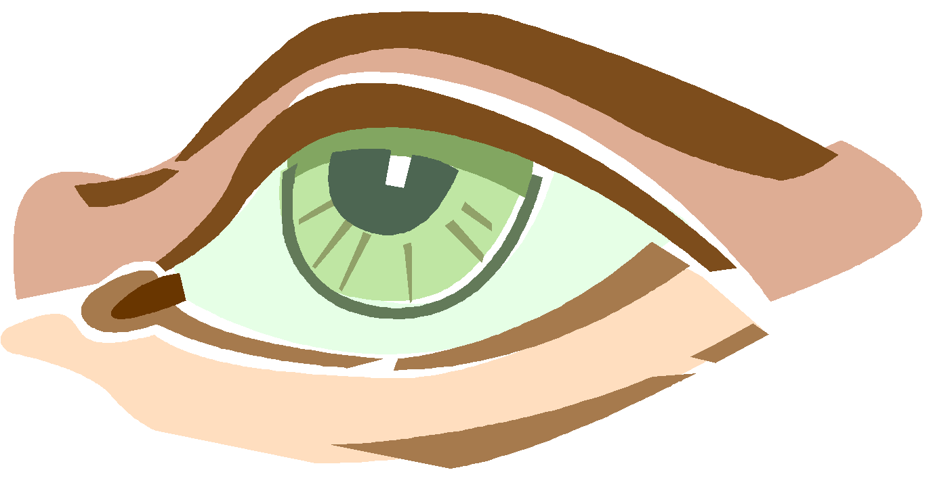
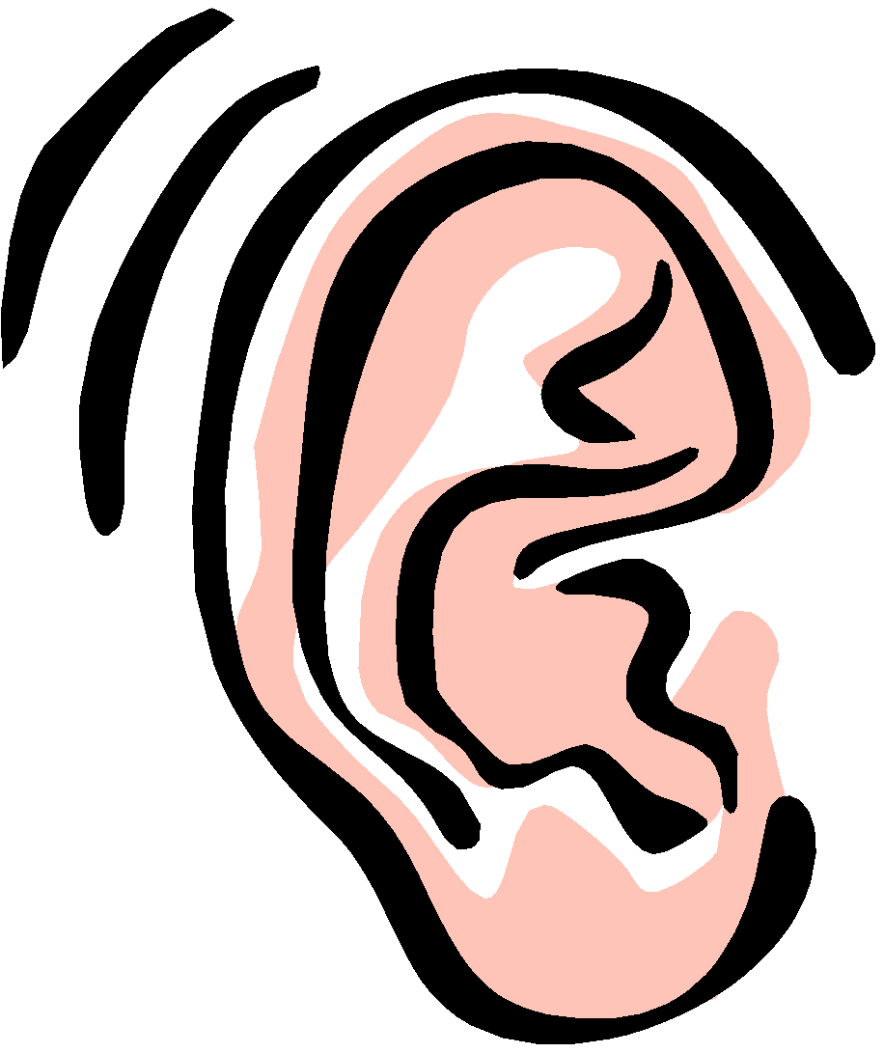
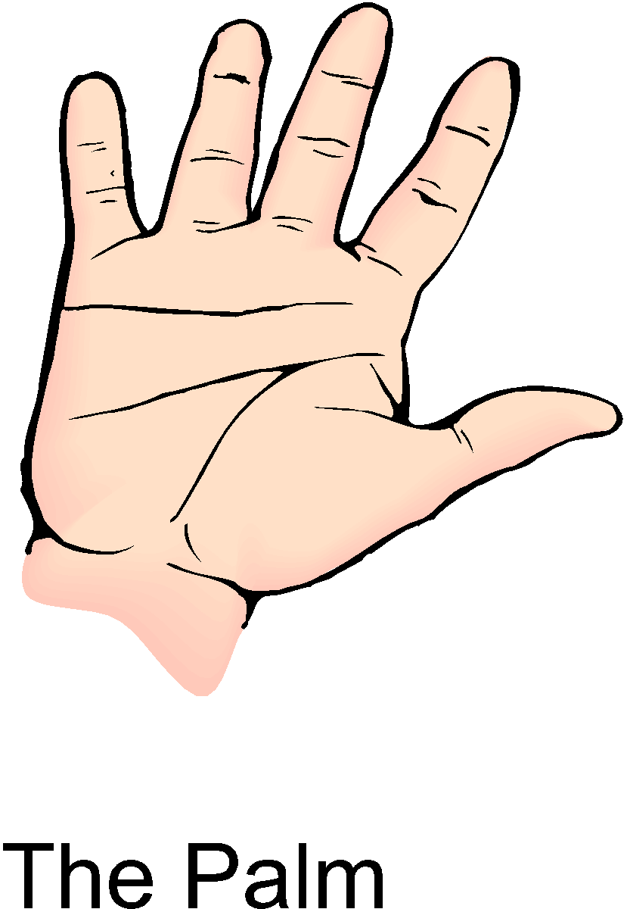
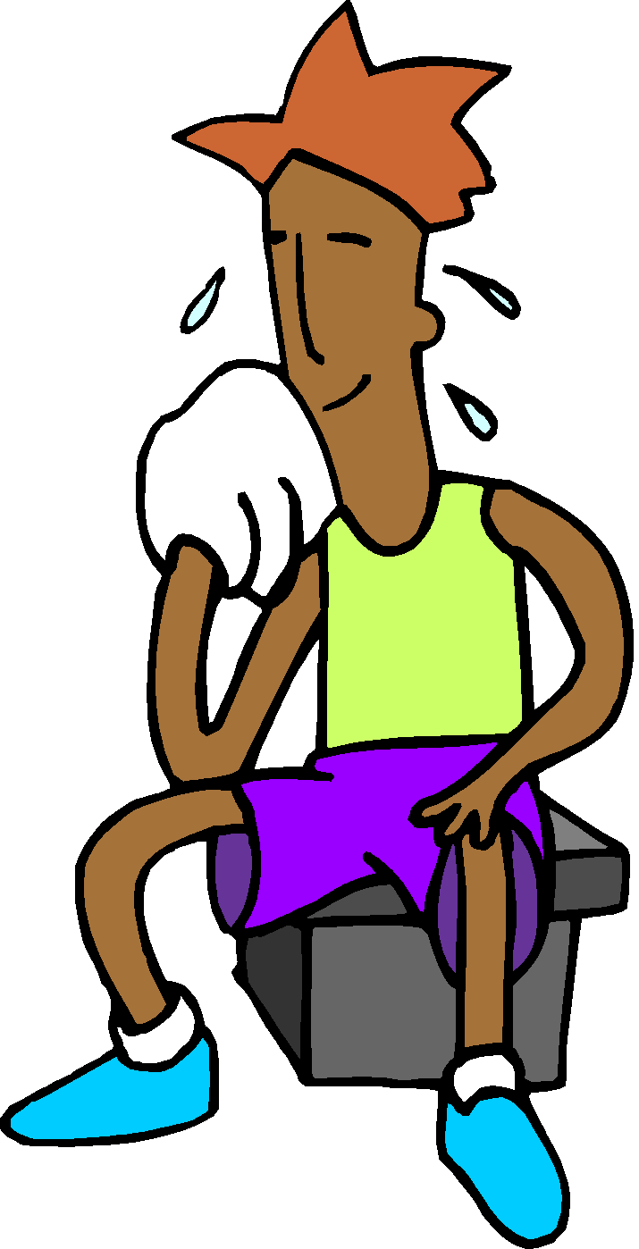
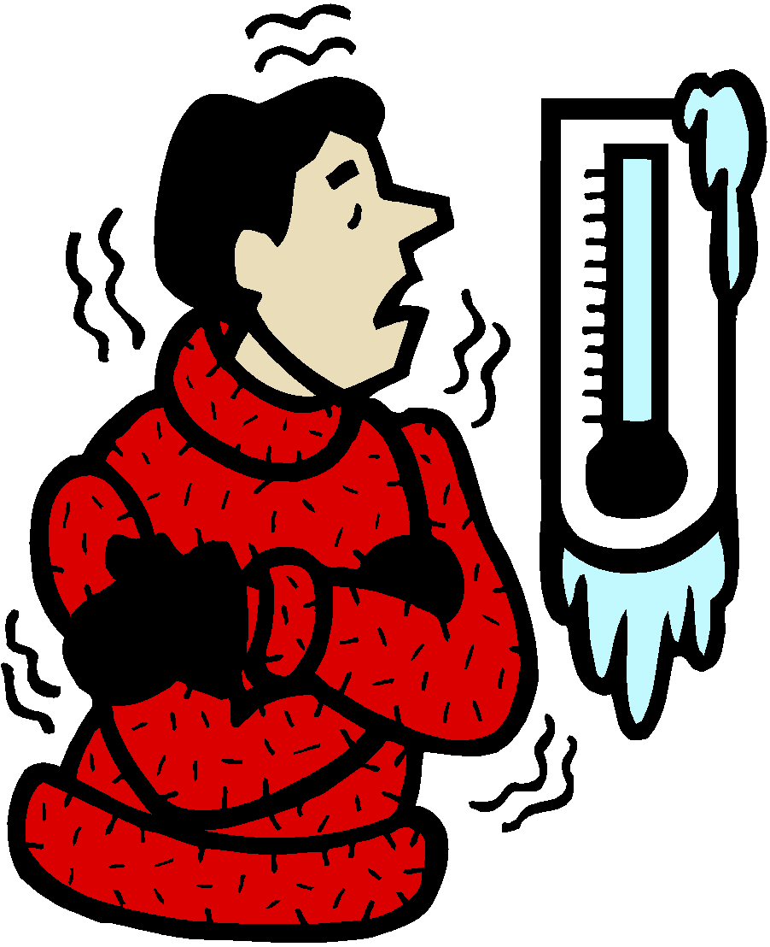
The Nervous System
What is its FUNCTION?
Receives information about what’s happening inside and outside the body.
Directs the way your body responds to this info.
Helps maintain homeostasis.

Slide 24
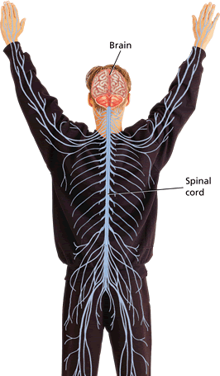
The Nervous System
The nervous system is made up of the:
Brain
Spinal Cord
Network of Nerves that branch out to ALL parts of your body

Slide 25
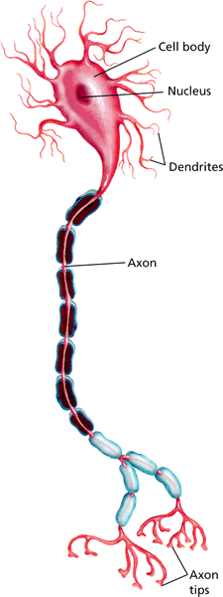
A Neuron (Nerve Cell)
AXON
DENDRITES
CELL BODY
AXON TIPS
Neurons carry information through the nervous system.
There are BILLIONS of neurons in your body.
They are constantly sending/receiving messages.
The message that a neuron carries is a nerve impulse.

Slide 26
A Neuron (Nerve Cell)
AXON
DENDRITES
CELL BODY
AXON TIPS
Direction message travels
AXON – carries the messages down to the AXON TIPS, which sends the message to the next neuron.
DENDRITES – receive messages and sends them toward CELL BODY (contains a nucleus).

Slide 27
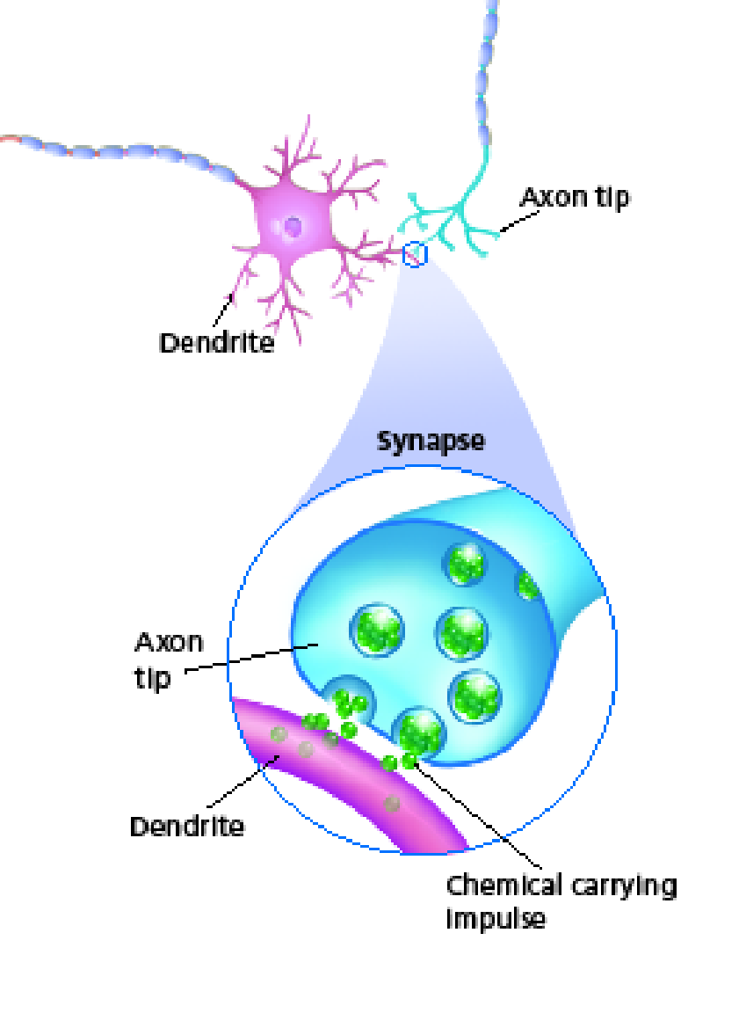
The Synapse
An impulse travels down the axon to the axon tips where it either travels to another neuron or to a muscle or gland to carry out a response.
The junction where one neuron can transfer an impulse to another structure is called a synapse.

Slide 28
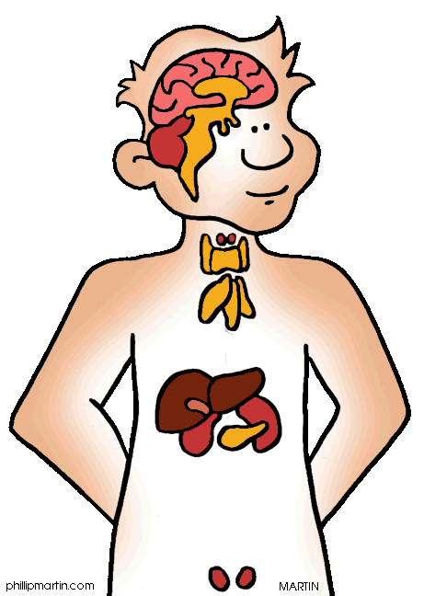
The Endocrine System
Pituitary gland – in the brain
Hypothalamus gland – in the brain
Thyroid gland – in the neck
Parathyroid gland – in the neck
Thymus gland – in the chest / heart region
Pancreas– in the trunk / main body region
Adrenal glands – on the top of each kidney
Ovaries (girls) and testes (boys)– in the reproductive organs

Slide 29
The Endocrine System
The Functions of the Endocrine System: The endocrine system produces __________________that control many of the body’s daily activities.
The endocrine system also _____________ long-term changes such as ______________ and ______________.
chemicals
regulates
growth
development

Slide 30
The Endocrine System
Made of…
The endocrine system is made up of _____________, organs that _______________________ a chemical.
Some glands, such as those that produce _________________________ release their chemicals into tiny tubes. The tubes deliver the chemicals to a _______________________ within the body or ________________________________.
glands
produces or releases
saliva and sweat
specific
location
to the
skin’s surface

Slide 31
The Endocrine System
Made of…
Hormones turn on, ________________ , speed up, or ________________ the activities of different organs and tissues. You can think of a hormone as a __________________.
Hormones are carried throughout the body by ______________________. Therefore, hormones can regulate activities in tissues and organs that are not close to the glands that produce them.
turn off
slow down
chemical messenger
the blood

Slide 32
The Endocrine System
Hormones work how?
In contrast to the body’s response to a nerve impulse, hormones usually cause a _________________________________ response.
When a hormone enters the bloodstream, it affects ____________ organs but not others.
A hormone interacts only with specific _________________ .
slower, but longer-lasting
some
target cells

Slide 33
The Endocrine System
Negative Feedback…
The endocrine system often uses ___________________ to maintain _____________________.
Through negative feedback, when the amount of a _____________________ in the blood reaches a certain level, the endocrine system sends signals that _________________ the release of that hormone.
negative feedback
homeostasis
particular hormone
STOP

Slide 34
Negative Feedback
Hypothalamus senses _______________ need __________ ________
cells
more energy
Pituitary decreases certain chemicals
Pituitary increases certain chemicals
cells
Hypothalamus senses ______________ have _______________ _____________
enough energy

Slide 35
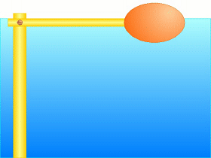
Toilet tank
You flush and the tank goes into the bowl.
The tank is empty.
Water turns on to fill it.
When tank is full, water turns off.

Slide 36
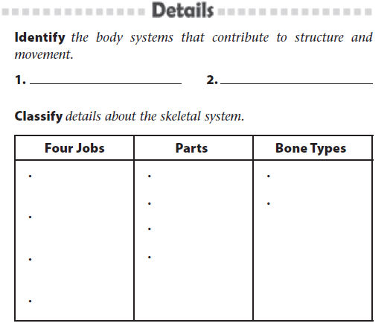
Structure, Movement, and Control
Skeletal
Muscular
Protect organs
BONES
Compact
Ligament
Spongy
Provide support
Tendon
Help mvmt
Cartilage
Store minerals

Slide 37
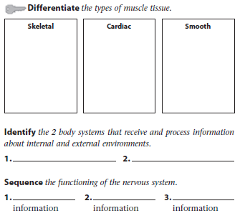
Structure, Movement, and Control
Works with skeleton
In heart only
Internal organs
Helps you move
Strong (not long-lasting)
Must work for a long time (enduring)
Strong, long-lasting (enduring)
Nervous
Endocrine
Receive
Process
Respond to

Slide 38
Structure, Movement, and Control
Read pages 347 – 352
Answer the questions on pages 353-354 (on your worksheet).
Be aware of things like RELATIONSHIP and COMPARE/CONTRAST
Answer at least ONE of the questions we posed together in class.

Slide 39
Homework:
As always, review your notes.
Finish the Structure, Movement, and Control notes.
We will test next week!!

